Slide 1
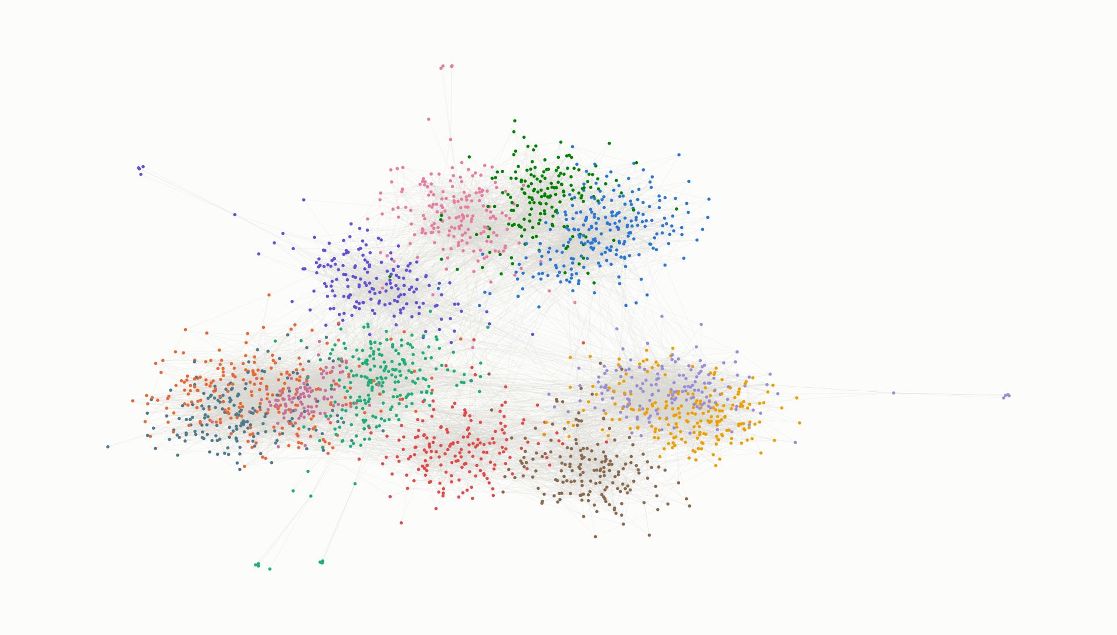
Graph ML for payment networks
DSI · GRAPH ML WORKSHOP
From a payment table to communities, features and embeddings
6 November 2026 · three hours, four labs
Notes:
Welcome. The picture on the right is a synthetic business payment network we will use all afternoon: about 2,200 businesses, a year of payments, coloured by the communities we will learn to find. Everything in the labs is invented data with planted answers, so we can check ourselves. At the very end I will show the same kind of picture drawn from our own payment network.

Slide 2
Three lenses on one payment network
TODAY
Time | Module | Lens | Lab
0:00 | Why graphs: Euler, graphs everywhere | — | —
0:10 | 1 · Vocabulary, basics and paths | macro | Lab 1
0:35 | 2 · Centrality and PageRank | macro | Lab 1
0:55 | 3 · Hubs first | macro | Lab 1
1:10 | 4 · Local structure and fraud | micro | Lab 2
1:35 | Break
1:45 | 5 · Communities, and how they change | meso | Lab 3
2:05 | 6 · Beyond independent rows: features, similarity | — | Lab 4
2:30 | 7 · Contagion and geography | meso | —
2:45 | 8 · Embeddings, pitfalls, our real network | — | demo
Notes:
The throughline for the afternoon: what the account view cannot see. Every module ends with something a single-customer view would get wrong or miss. Micro = the neighbourhood around one customer; meso = communities; macro = the whole network. If we run long, the GNN slides go first, then the geography slide.

Slide 3
This is what our payment network looks like
THE HOOK
[ community_map.png from pkg_community_map_workshop.ipynb ]
One bubble per community · colour = main sector · links = dollars between communities
By the end of today you will know how this picture was made.
Notes:
Replace the placeholder with community_map.png from the real-data notebook (or open community_map.html live). Show it for 30 seconds, no explanation yet. Present from your own screen and do not hand out the file: it is real customer data. We come back to it in the last ten minutes.

Slide 4
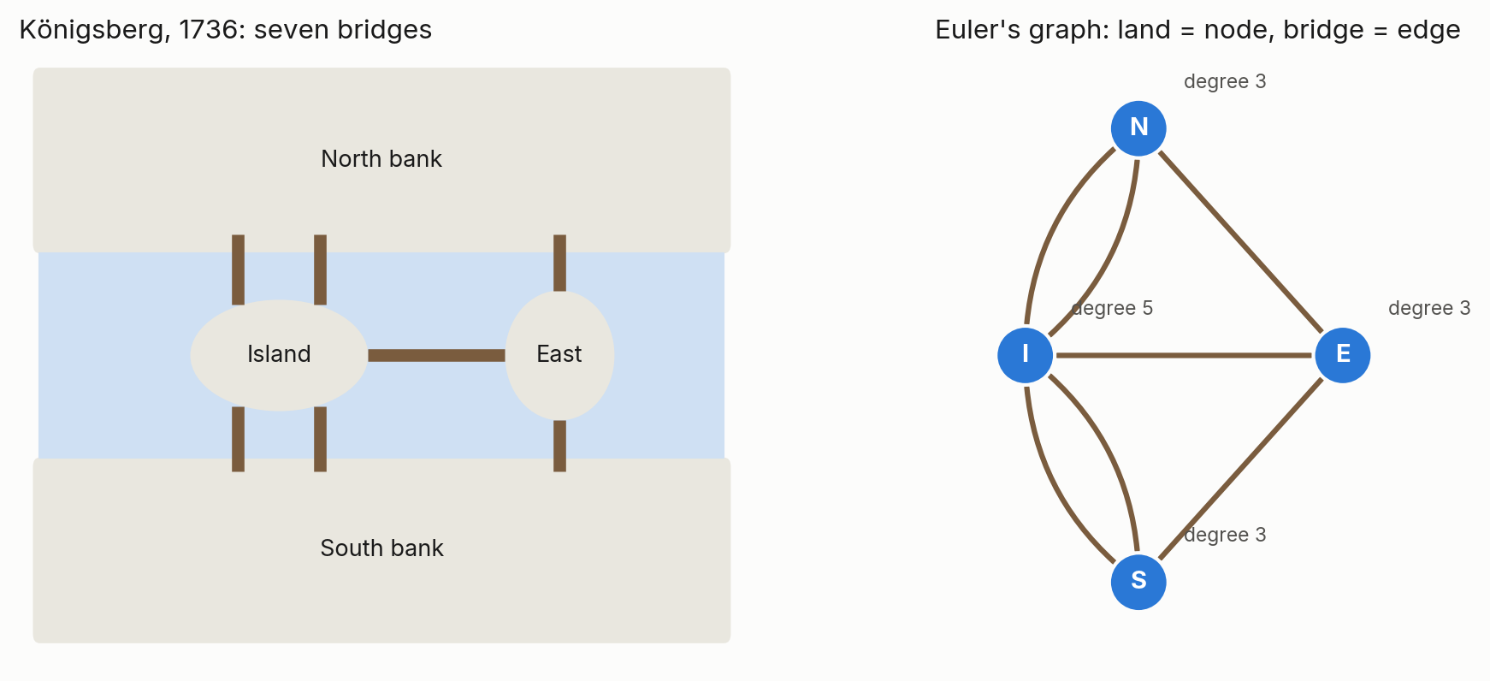
Graph theory starts with seven bridges
1736
Can you walk every bridge exactly once? Euler threw away the map and kept only who connects to whom. Three land masses have an odd number of bridges, so no such walk exists.
Notes:
Leonhard Euler, 1736. The point is the abstraction: the answer depends only on connections, not on distances or shapes. That is exactly what we do with a payment table: keep who pays whom, drop everything else, and new questions become answerable. A walk that uses every edge once needs zero or two nodes of odd degree; Königsberg has four.

Slide 5
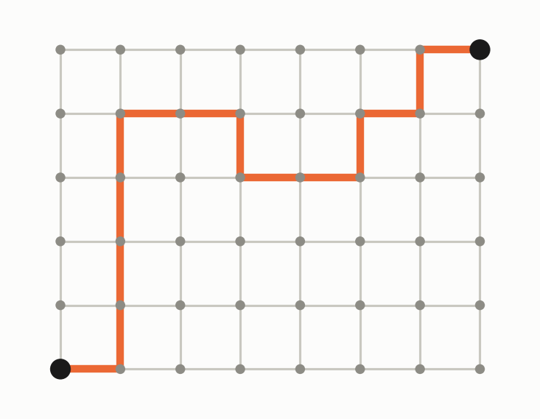
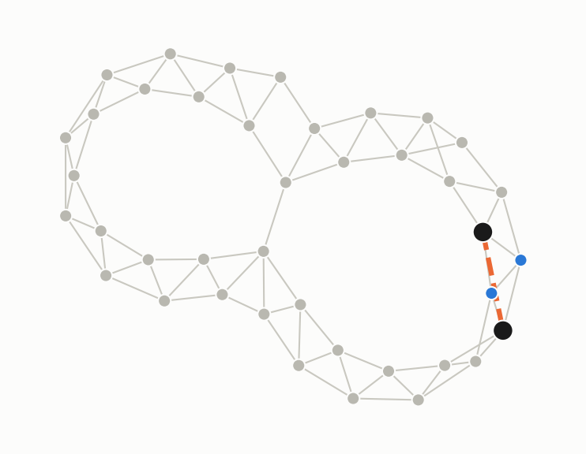
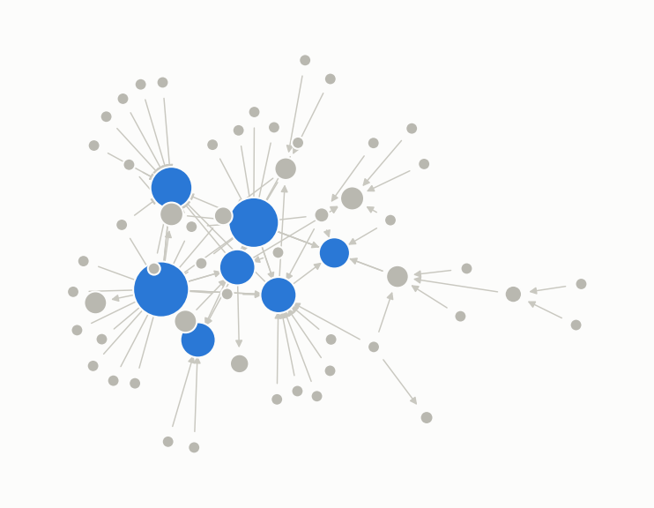
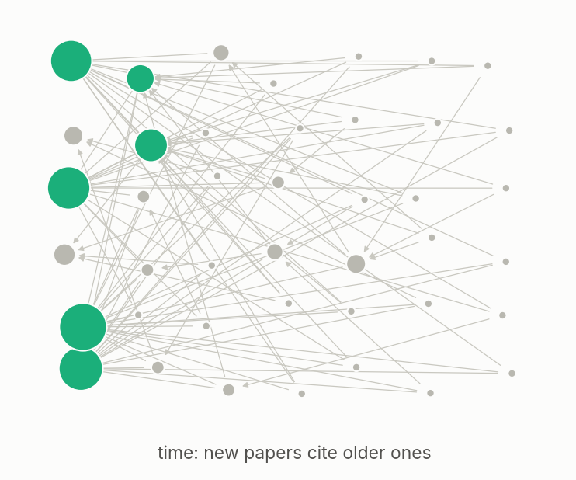
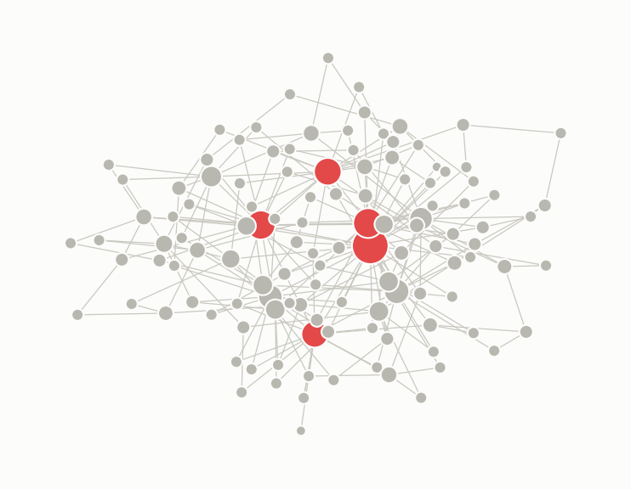
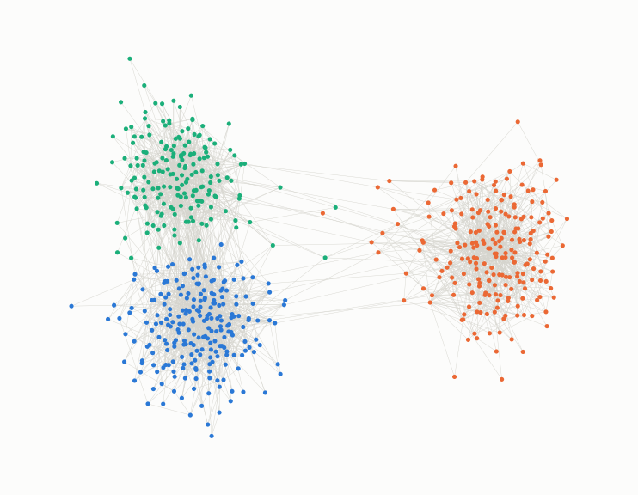
Graphs everywhere: one question, one algorithm
Roads · fastest route?
Social · who to befriend?
Web · which page matters?
Shortest path (Dijkstra) · module 1
Shared neighbours · module 5
PageRank · module 2
Citations · which paper is influential?
Proteins · which are essential?
Payments · where is risk, who is in the ring?
In-degree, PageRank’s ancestor · module 2
Hubs and communities · modules 2 and 4
All of the above · today
Notes:
The gallery doubles as the agenda: every tile is a technique we use today. Roads: navigation apps. Social: People You May Know is triadic closure. Web: PageRank. Citations: PageRank was inspired by citation counting. Proteins: hubs tend to be essential. Payments: everything at once. Ask the room which tile they think is hardest; the answer is usually payments, because the data is incomplete (we only see our own bank's side).

Slide 6
Basics and paths
MODULE 1 · 25 MINUTES · LAB 1
The words, a payment table as a graph, and how small the world is.
Notes:
Open Lab 1 now so it is loaded while we talk. Sections 1 to 3 of the lab go with this module.

Slide 7
Same ideas, different words
MODULE 1 · VOCABULARY
Term | Also called | In our payment data
Graph | network | all payments among our customers and their counterparties
Node | vertex, actor | a customer or counterparty account
Edge | link, tie, relationship | payments from A to B in a period
Directed edge | arc | payer → payee
Weight | strength when summed | dollars, or number of payments
In-degree / out-degree | fan-in / fan-out | number of distinct payers / payees
Neighbourhood | 1st-order, 2nd-order | direct partners; partners of partners
Ego graph | ego network | one customer, its partners, and the links among them
Path, hops | walk (if nodes repeat) | a chain of payments; hops = edges on it
Component | connected component | everyone reachable from everyone else
Density |  | share of possible links that exist (tiny in payments)
Notes:
Mathematicians say graph, vertex and edge; physicists and sociologists say network, node and link or tie. They mean the same things, and the libraries mix them: NetworkX says nodes and edges, igraph says vertices and edges. Density in a payment network is tiny: a few partners out of millions of possible ones, which is why we store edge lists, not matrices.

Slide 8
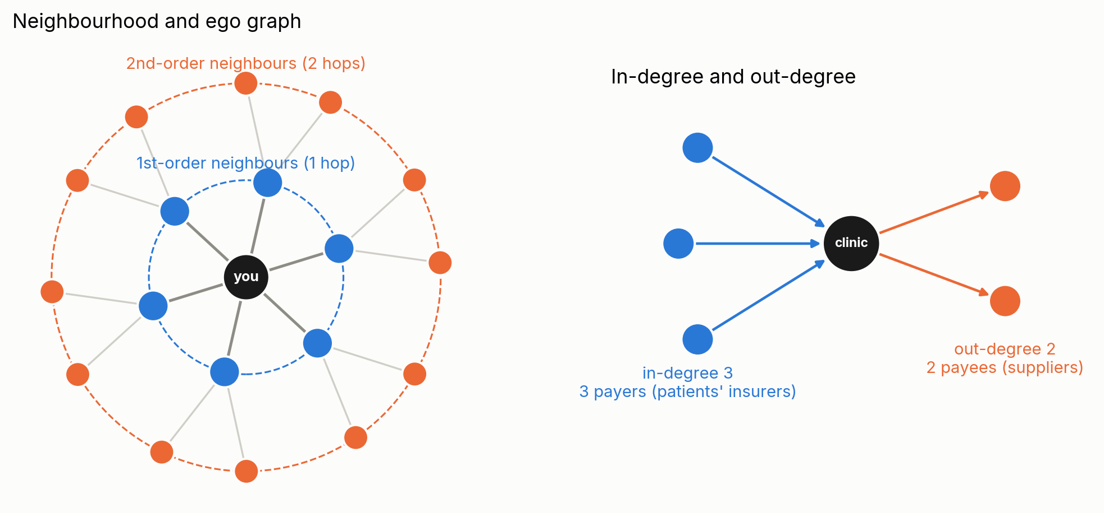
Neighbourhoods, ego graphs and the direction of money
MODULE 1 · VOCABULARY
Utility
Payroll processor
Funnel account
in-degree in the thousands, out-degree a handful: everyone pays it, it pays few.
both huge: employers pay in, employees are paid out.
many payers, one payee: in-degree 30, out-degree 1. Lab 2.
Notes:
First-order neighbourhood: everyone one payment away. Second-order: their partners. The ego graph is the first-order neighbourhood plus the links among those partners: it is the unit of Lab 2. In-degree counts distinct payers, out-degree distinct payees; with dollars instead of counts they become in-strength and out-strength. The ratio of in to out already separates collectors, payers and pipes.

Slide 9
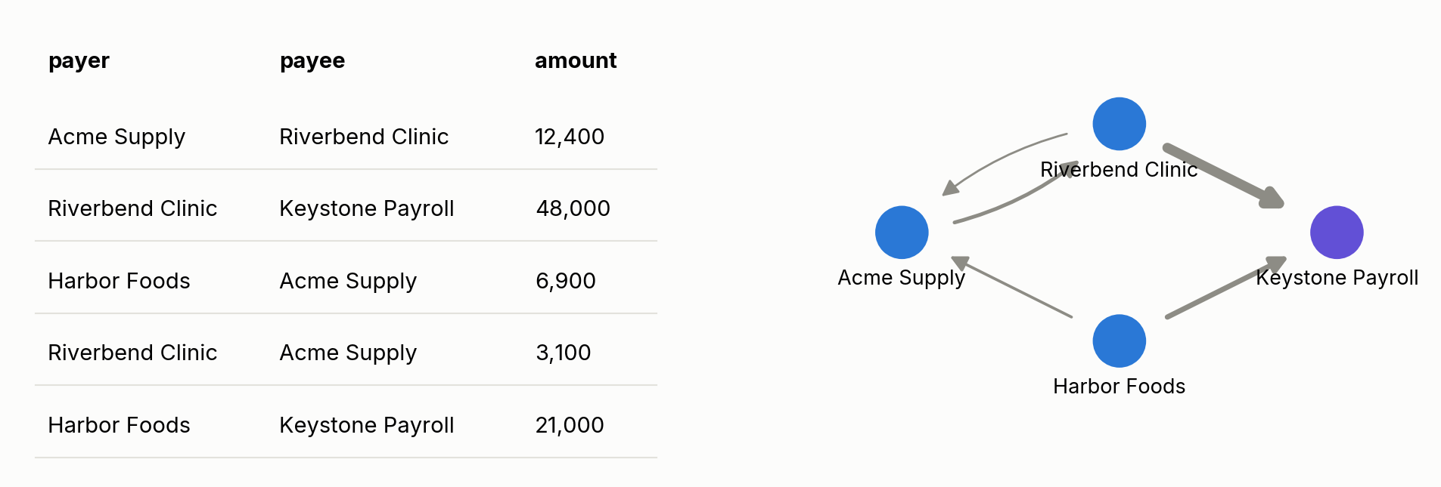
A payment table is already a graph
MODULE 1 · BASICS
Node
Edge
Weight
an account holder
payer → payee, directed
dollars or payment count
Notes:
Every row of an edge table is an arrow. Group-by on payer gives out-degree; group-by on payee gives in-degree. Most graph features are a SQL group-by away; the graph view just tells you which group-bys are worth writing. Note the hub-like payroll processor: two arrows already point at it in five rows.

Slide 10
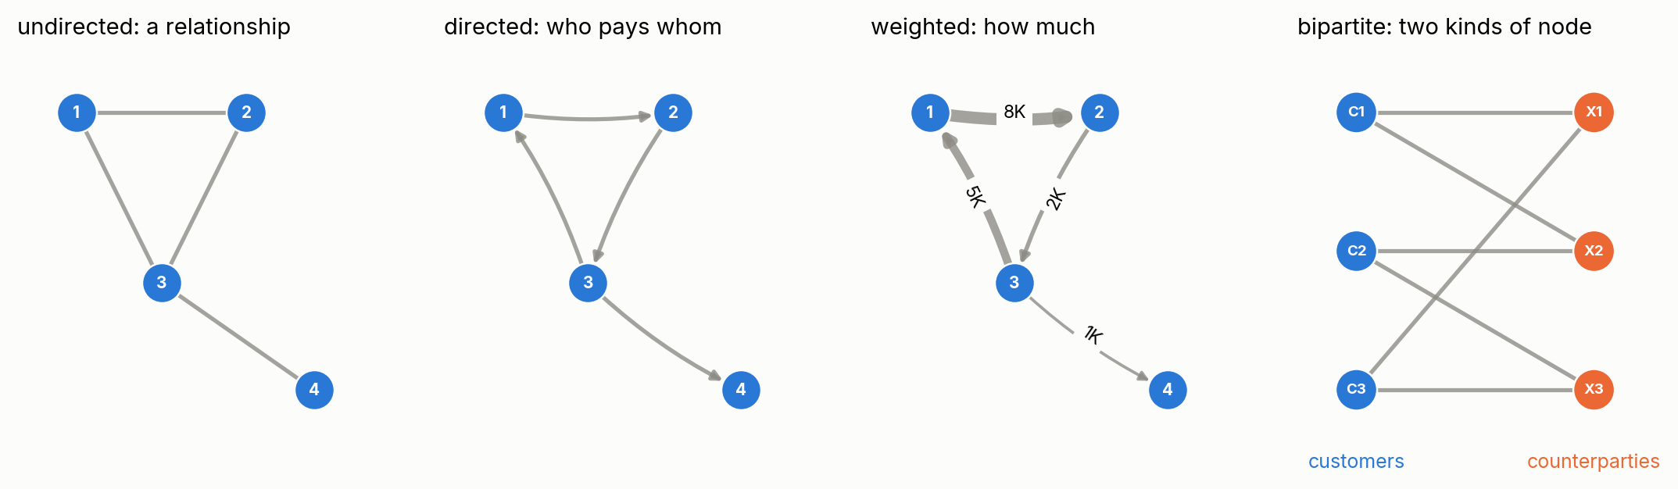
Four words you will hear all afternoon
MODULE 1 · BASICS
Degree
Strength
Path
number of distinct partners. In-degree = payers, out-degree = payees.
total dollars in or out. Degree counts partners, strength counts money.
a chain of edges. Hops = number of edges on the shortest one.
Notes:
Bipartite matters for us: customers on one side, counterparties at other banks on the other. Edges only run across. Distinct counterparties paid is a degree, and in our attrition work the number of distinct institutions paid was the best single early signal: a degree feature.

Slide 11
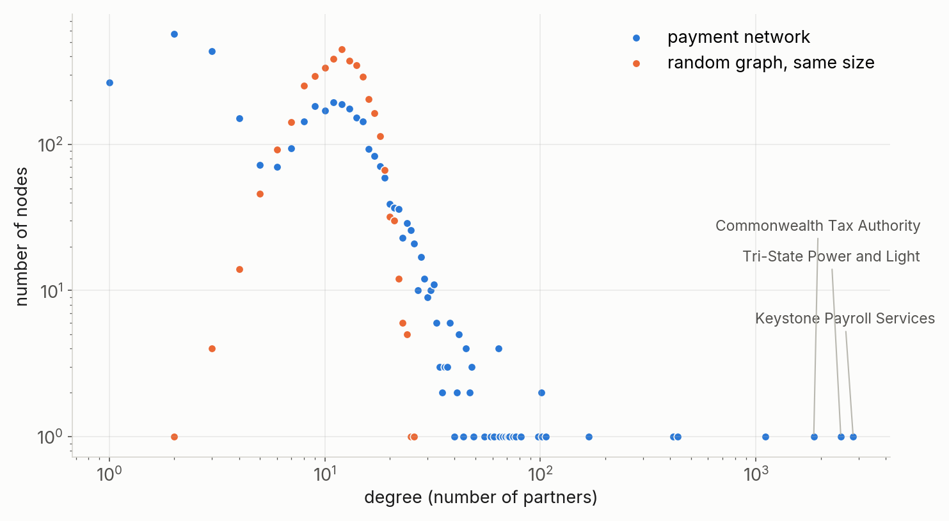
Real networks have hubs
MODULE 1 · HUBS
Most businesses have a handful of partners. A payroll processor, the tax agency and the utility have thousands.
A random graph of the same size has no hubs at all: the bell in orange.
Notes:
Log-log axes. Blue: our synthetic payment network, heavy tail. Orange: a random graph with the same number of nodes and edges, every node has about ten partners. Hubs are real and important, but they connect almost everyone to almost everyone, so they hide the structure we want to see.

Slide 12
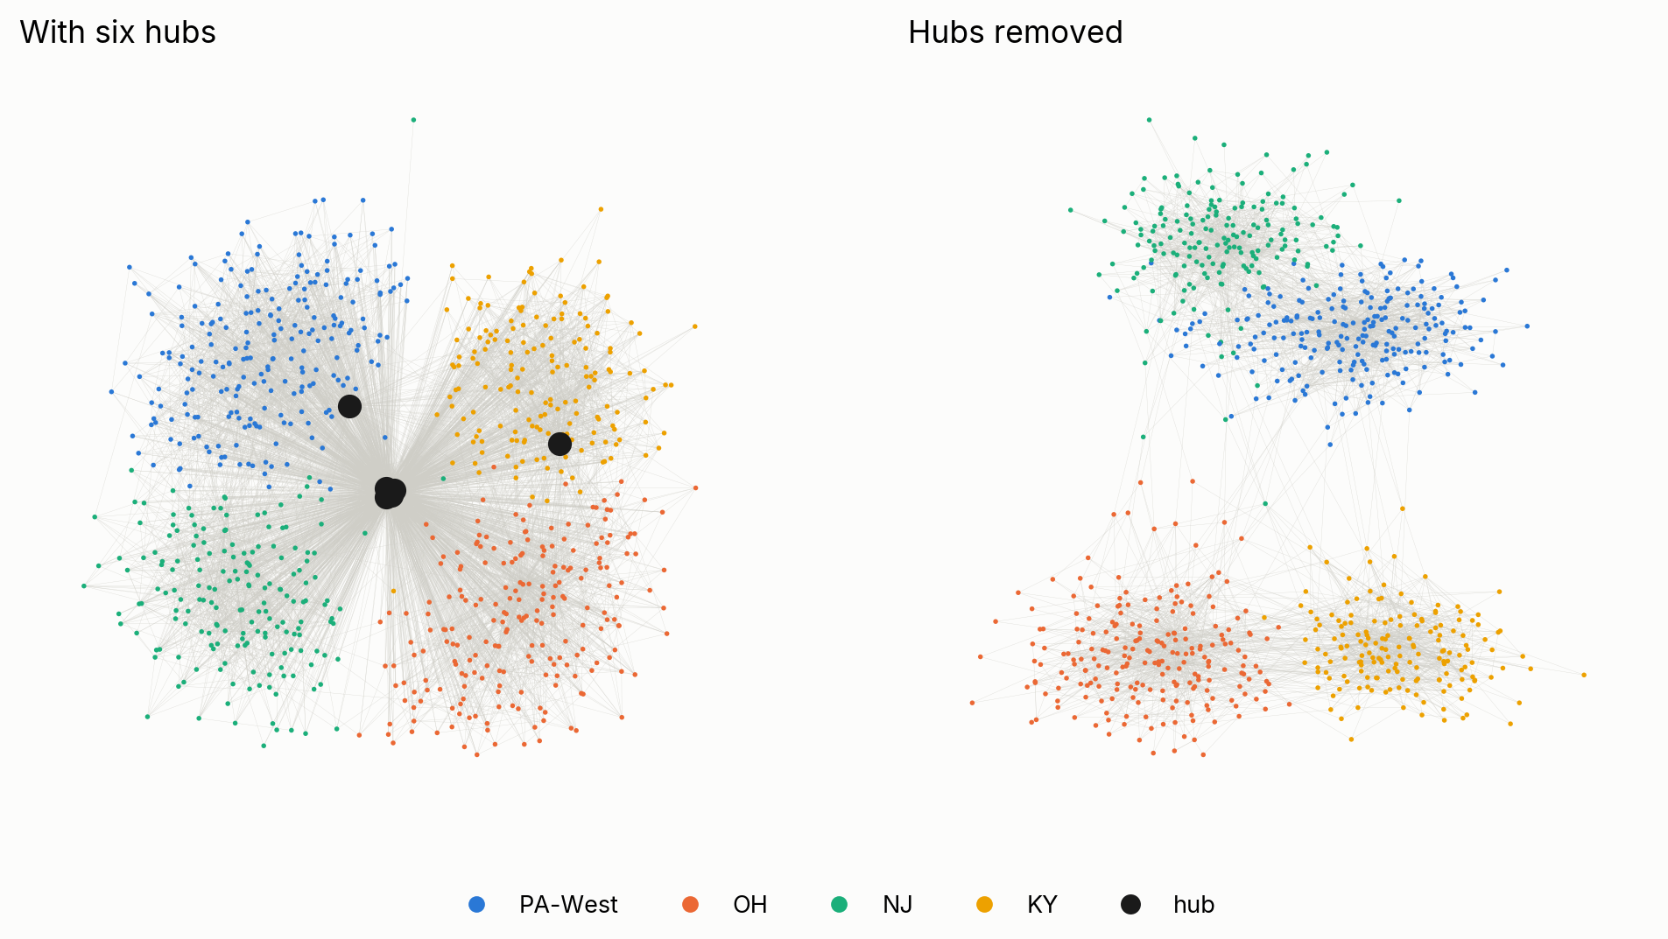
Remove six hubs and the structure appears
MODULE 1 · HUBS
Rule of thumb: a hub has more than 15 times the median degree. Always review the list by hand.
Notes:
Same businesses, colour = region (which the bank knows). Left: the six payment-infrastructure hubs pull everything to the middle. Right: four regional clusters. Percentile rules ("top 0.1%") break when hubs have similar degrees; the median-multiple rule is more robust. In the lab the rule also catches one big supplier: is that a hub or just a big supplier? Discuss.

Slide 13
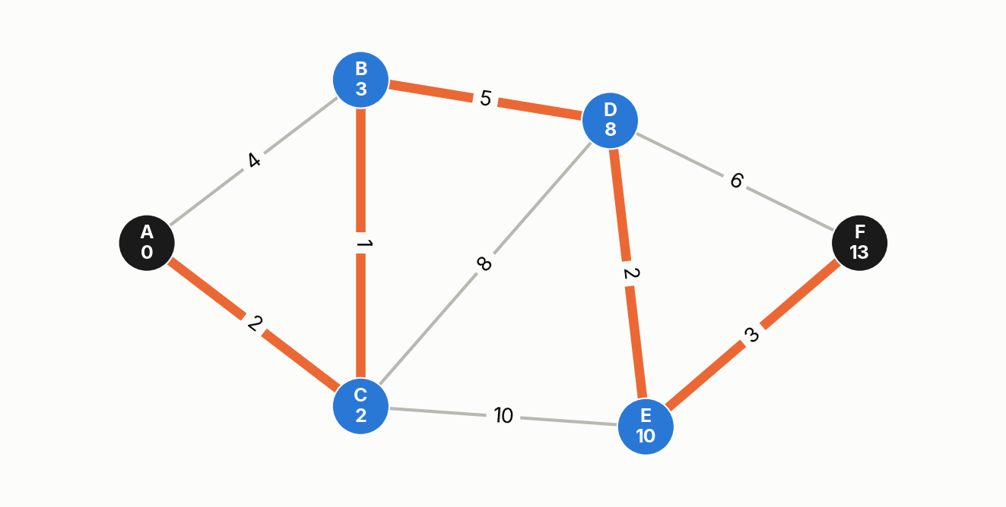
Twenty minutes on a café terrace
1956 · AMSTERDAM
Edsger Dijkstra designed the shortest-path algorithm in his head while shopping with his fiancée. He published it three years later.
Every navigation app descends from it. In payments: how many hops is this business from a flagged entity?
Notes:
Dijkstra: always settle the unvisited node with the smallest known distance, then update its neighbours. Numbers under each letter = distance from A. Modern navigation preprocesses the road graph (for example contraction hierarchies) and can be several orders of magnitude faster, but the idea is the same. Source: Dijkstra interview, Communications of the ACM 2001; published 1959.

Slide 14
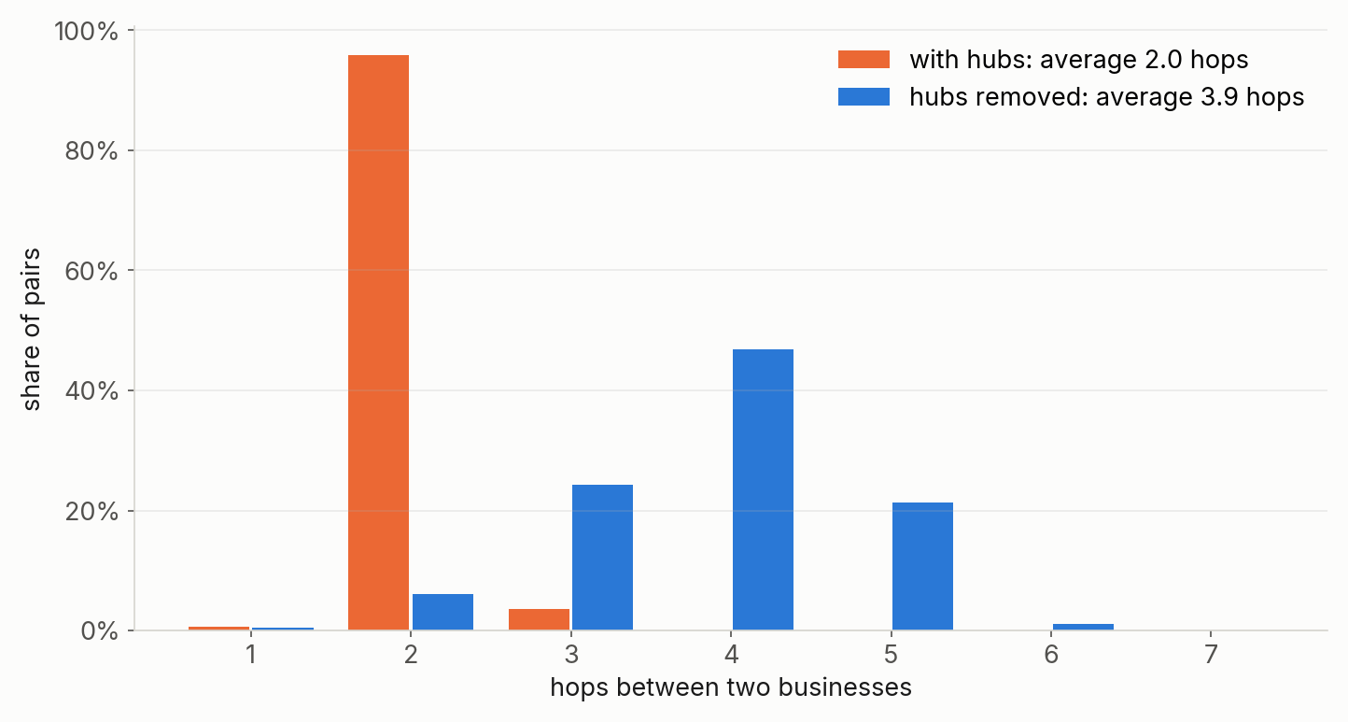
Six degrees, then 3.57
MODULE 1 · PATHS
1929 Karinthy imagines six degrees of separation
1967 Milgram’s letters reach strangers in about six steps
2016 Facebook: 3.57 people in between, across 1.59 billion users
Our businesses: 3.9 hops apart without hubs, 2.0 with them.
Notes:
Facebook's 2016 figure counts intermediaries: 3.57 people means about 4.57 friendship links on average, measured over its active accounts at the time, not all of humanity; in 2011 it was 3.74 among 721 million users. With hubs, every two businesses are two hops apart through the payroll processor: true and useless. Without hubs, distances mean something again.

Slide 15
Centrality
MODULE 2 · 20 MINUTES · LAB 1
“Important” has several meanings. Each one answers a different business question.
Notes:
Lab 1, section 4. Start with the guessing game before anyone runs the cell.

Slide 16
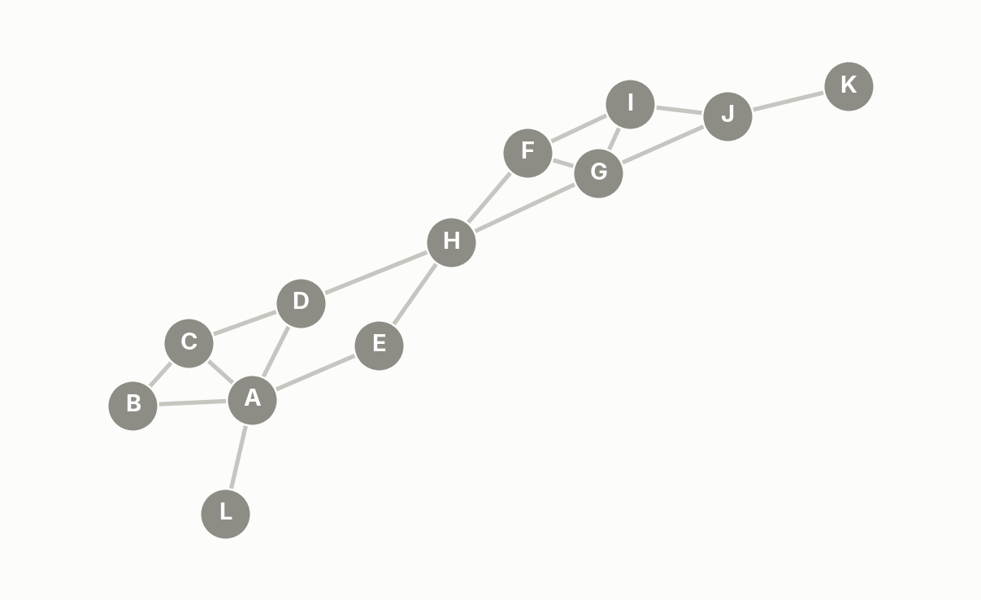
Guess the winner: which node is the most important?
MODULE 2 · CENTRALITY
Notes:
Give the room thirty seconds. Ask for a show of hands: A, H, or something else? Most people pick A (most connections) or H (in the middle). Both are right, for different questions. Next slide.

Slide 17
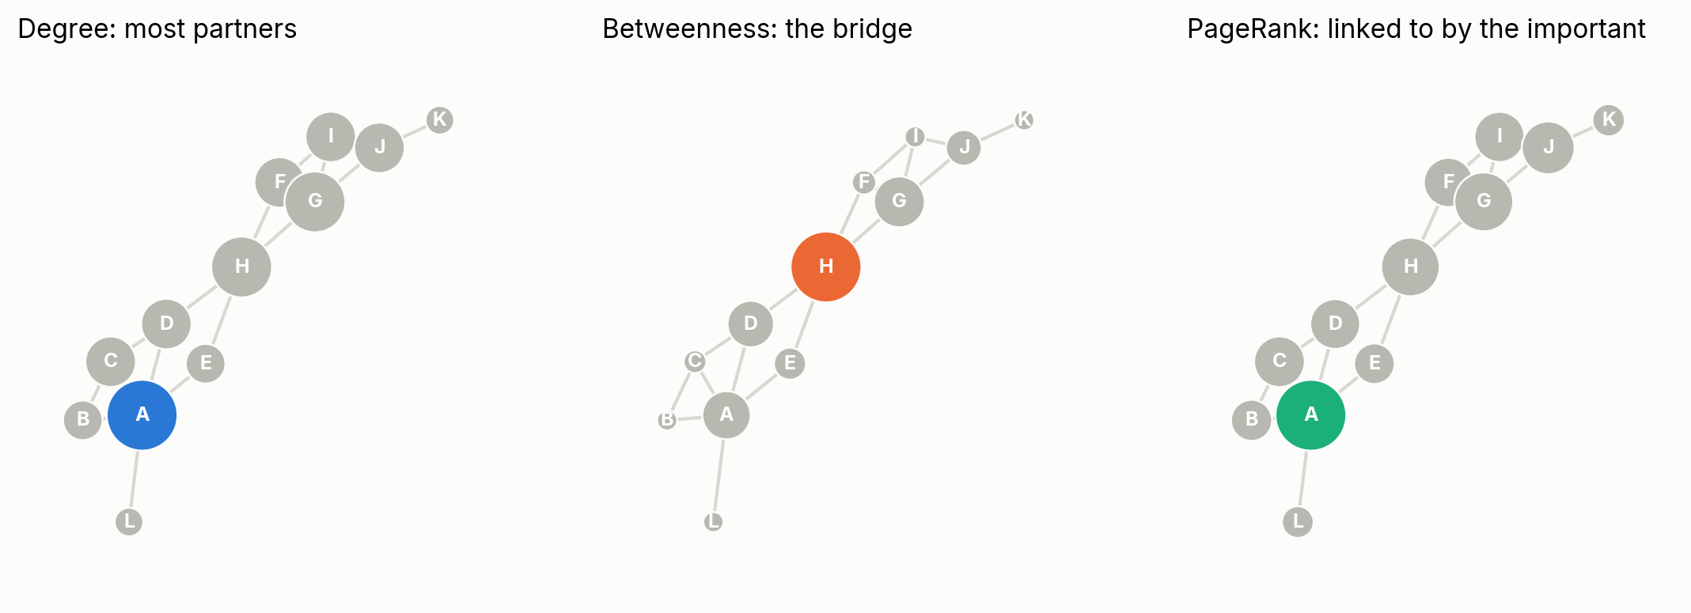
Same network, different winners
MODULE 2 · CENTRALITY
Degree
Betweenness
PageRank
most partners. Who is busiest?
on the most shortest paths. Who is the bridge?
linked to by the important. Where does money end up?
Notes:
A has five partners and wins degree and PageRank. H joins the two halves: remove it and the network falls apart, so it wins betweenness. In a payment network a high-betweenness business is a bridge between ecosystems: if it fails, two groups lose their only link. Closeness (near everyone) is a fourth answer; it also favours H.

Slide 18
The graph algorithm nobody wanted to buy
THE PAGERANK STORY
$750K
$3B
$336M
Excite, 1999
Yahoo, 2002
Stanford, 2005
Brin and Page asked 1 million dollars, were talked down to 750 thousand. Excite’s CEO said no.
Yahoo offered about 3 billion. The founders held out for at least 5. No deal.
Stanford owned the patent, took 1.8 million Google shares for it and sold them for 336 million.
Notes:
Excite, early 1999: the founders asked 1 million; Vinod Khosla talked them down to 750 thousand; CEO George Bell still said no. Bell later said the sticking point was that Page wanted Excite's own search technology ripped out and replaced (CNBC, 2015). Yahoo and AltaVista reportedly also passed in the early days. Yahoo, summer 2002: Terry Semel offered roughly 3 billion; the founders wanted at least 5 (Wired, 2007). Stanford held the PageRank patent (it expired in January 2019), licensed it to Google for 1.8 million shares and sold them in 2005 for 336 million dollars. The lesson for us: the value of a graph algorithm is easy to underestimate.

Slide 19
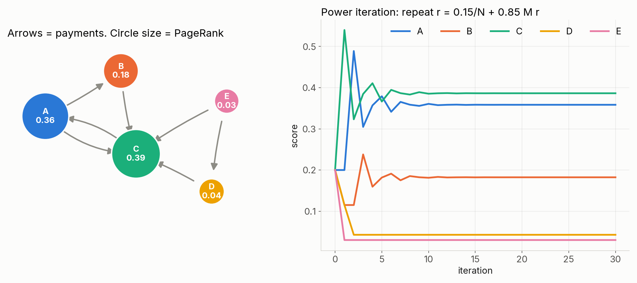
A random surfer, a few lines of numpy
MODULE 2 · PAGERANK
Follow a random outgoing link 85% of the time, jump anywhere 15% of the time. A node’s score is the share of time spent there. You are important if important nodes pay you.
Notes:
The power iteration in the lab is ten lines and matches networkx to four decimals. Note D and E: they pay into the network but nobody pays them, so they keep only the 15% teleport share. On the payment network, the highest PageRank goes to suppliers paid by businesses that are themselves paid a lot: suppliers to the suppliers. Brin and Page, 1998.

Slide 20
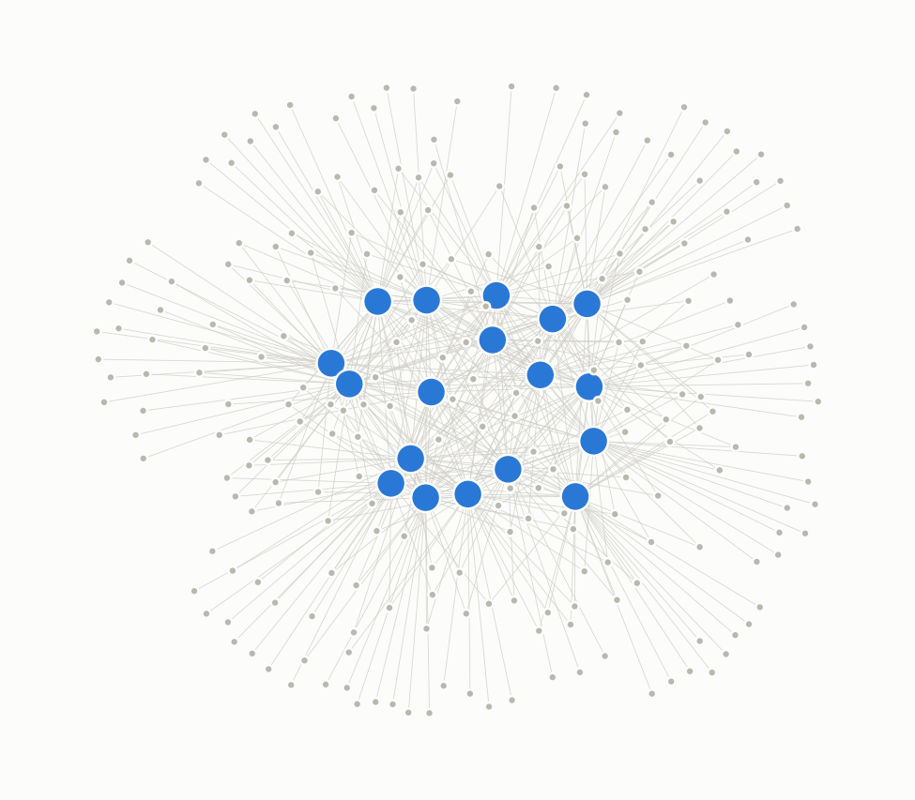
Hubs matter in cells and in banking
MODULE 2 · CENTRALITY IN OTHER DOMAINS
Proteins, 2001
Fedwire, 2007
In yeast, the most connected proteins are the most likely to be essential. Later work argued hubs are simply in more interactions, not special by position: a lesson in correlation versus mechanism.
The New York Fed mapped interbank payments: about 6,600 banks and 70,000 links on a day, a small dense core, compact despite low connectivity. Its shape changed right after September 11.
Notes:
Jeong, Mason, Barabási and Oltvai, Nature 2001: centrality-lethality rule. He and Zhang, PLoS Genetics 2006: essential interactions explain it, not network architecture. Soramäki, Bech, Arnold, Glass and Beyeler, The topology of interbank payment flows, NY Fed Staff Report 243 (2006), Physica A (2007). The picture on the right is illustrative, not Fedwire data.

Slide 21
Hubs first
MODULE 3 · 15 MINUTES · LAB 1
Before any centrality, community, similarity or risk score: find the hubs, name them, and decide what to do with each one.
Notes:
The first thing to do with any new graph. Every later module depends on this step.

Slide 22
The hubs we have met in our own data
MODULE 3 · HUBS FIRST
Payment processors
Other banks and ledger accounts
Insurers
PayPal, Stripe, buy-now-pay-later and earned-wage apps. Money passes through them on behalf of thousands.
Clearing, settlement and internal book-transfer accounts. A pipe between two real parties, not a business.
Premiums in, claims out. One insurer appeared under hundreds of thousands of raw ids before entity resolution.
Government
Payroll processors
Utilities, telecom, card acquirers
Treasury, IRS, Veterans Affairs: taxes in, benefits and refunds out, for almost everyone.
Employers pay in, employees are paid out. Links every employer to every employee.
Everyone pays the power company; merchant-services accounts settle card sales for whole sectors.
Notes:
These names come from our own counterparty work: rotators like PayPal, Stripe, Affirm and EarnIn; VACP TREAS for Veterans Affairs and Treasury; CIGNA as the largest entity-resolution merge. Each is a real economic actor. Ask the room which hubs they have seen in their own tables.

Slide 23
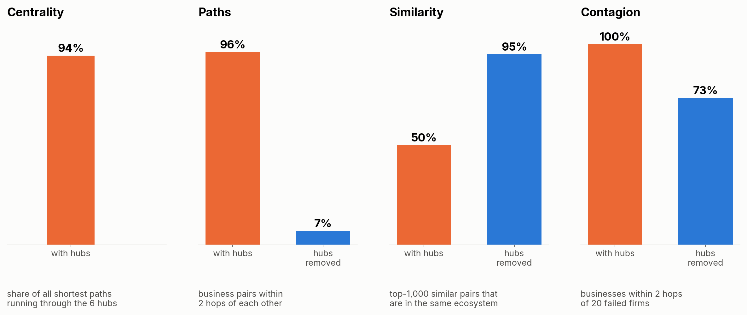
Leave hubs in and every method is fooled
MODULE 3 · HUBS FIRST
Centrality
Paths
Similarity
Contagion
the top 6 by PageRank are the 6 hubs; they sit on 94% of shortest paths.
with hubs, almost every pair is 2 hops apart. The path means nothing.
sharing the power company makes everyone look alike.
every failure seems to reach everyone, through a utility that will not fail.
Notes:
All four numbers are computed on the synthetic network with its 6 hubs. Communities: on this data Louvain still finds the ecosystems with the hubs in (agreement 0.85 either way), because it can park each hub in one community; but the hub lands in an arbitrary community and every drawing turns into the hairball we saw. Same lesson as the Fedwire core: a few nodes carry most of the paths.

Slide 24
Detect, classify, decide
MODULE 3 · HUBS FIRST
1 · Detect
2 · Classify
3 · Decide, per task
Degree far above the rest: 15 × the median here, top 0.1% on our real data. Look at payers and payees separately. Print the list.
Read the names. A pipe (processor, clearing, ledger)? A real counterparty (utility, insurer, government)? One of our own clients serving many others?
Remove for communities, paths and similarity. Down-weight for similarity and link prediction (1 / log degree). Keep as a feature: share of spend through processors. Keep in for contagion when the hub itself can fail.
A hub can fail too: the February 2024 cyberattack on Change Healthcare, a claims clearinghouse, held up payments to providers across the country for weeks.
Notes:
No single rule: the same hub is removed for community detection and kept for single-point-of-failure risk. Hubs also carry signal: in our locatability work, government and utility hubs located well because their payers cluster, while national processors located nowhere. Degree does not decide locating power; how spread out the payers are does. Keep the hub list under version control and review it by hand.

Slide 25
Local structure and fraud
MODULE 4 · 25 MINUTES · LAB 2
The account view sees totals. The network view sees who is on the other side, and how far the nearest known fraud case is.
Notes:
Lab 2. The four accounts are in the first cells; do the guessing on screen before scrolling to the measures.

Slide 26
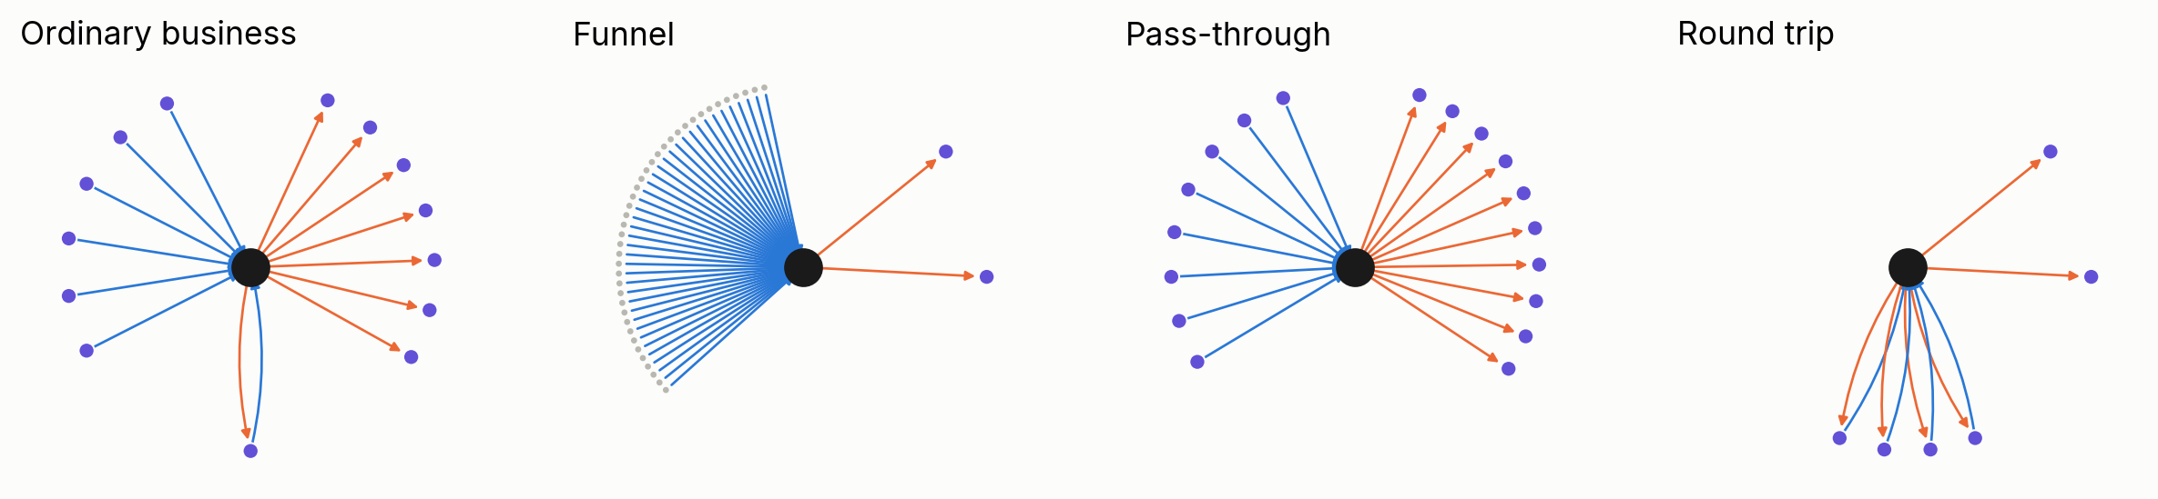
Four ordinary totals, four different shapes
MODULE 4 · ACCOUNT VIEW VS NETWORK VIEW
Account | Account view | Network view
Funnel | many small credits, one large debit | 40 unrelated individuals → 1 payee
Pass-through | busy client, money in and out | in from 8 firms, out to 10 others, within days
Round trip | two unrelated payments | same 4 partners on both sides, same amounts
Notes:
Blue lines are money in, orange are money out; partners at the bottom appear on both sides. In the lab the account-view table comes first: the four accounts look unremarkable. Then the ego networks. Ask the room to call each one before revealing.

Slide 27
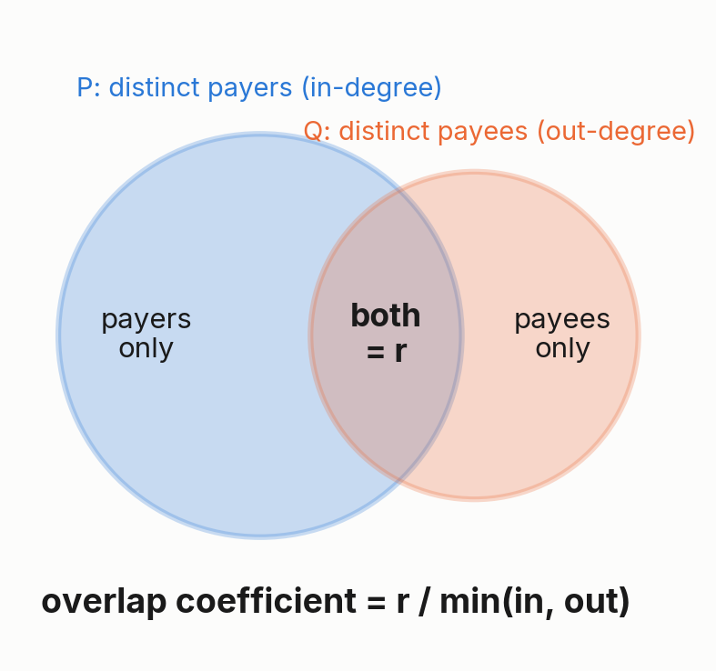
Partners on both sides
MODULE 4 · ONE-HOP MEASURES
r = in + out − distinct partners. If distinct ≈ max(in, out), then r ≈ min(in, out): almost every partner on the smaller side is also on the other side.
Measure | Points at
fan-in ratio | many in, few out: funnel
throughput | money leaves as it arrives
individual payer share | a business paid by people
loop symmetry | what goes out comes back
Guard: require min(in, out) ≥ 3.
Notes:
The overlap coefficient formalises the idea of in-degree plus out-degree being close to the maximum of the two. Throughput = min(in dollars, out dollars) / max. Loop symmetry: for each partner on both sides, min(out, back) / max. Without the guard, one payer who is also the one payee scores a perfect 1.

Slide 28
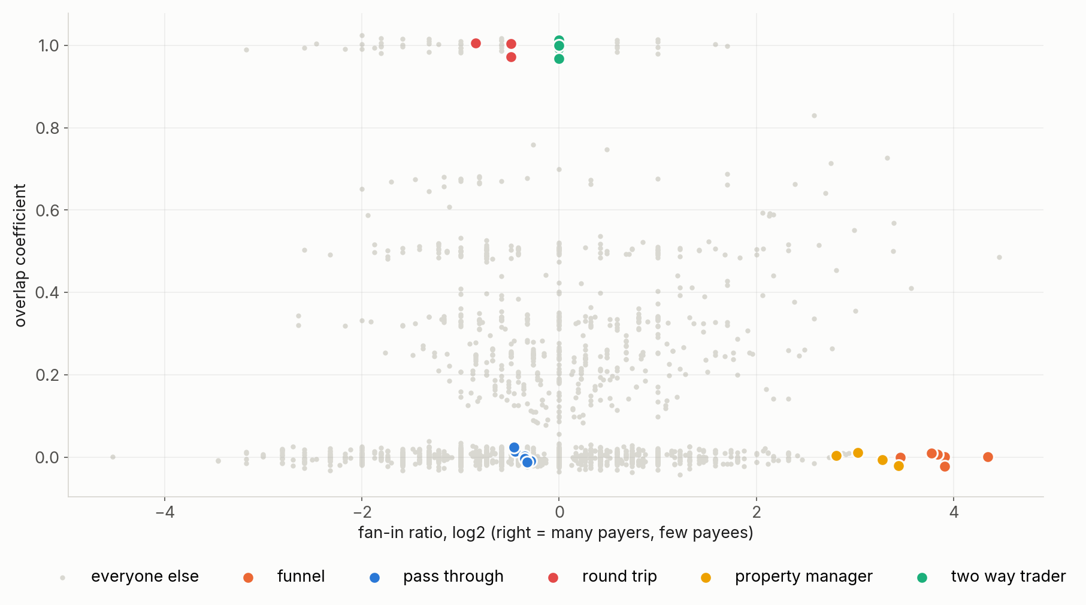
Shape finds candidates. Context decides.
MODULE 4 · THE BEHAVIOURAL MAP
Rule | Shape | + timing
funnel | 10 | 6
pass-through | 32 | 10
loop | 15 | 5
Timing and history cleared all 4 property managers and all 8 two-way traders: legitimate look-alikes.
Notes:
Synthetic data with planted cases. Shape rules alone flag 57 businesses. Adding evidence from daily transactions (money out within 5 days, first in first out), history (did the pattern exist six months ago?) and loop amounts (same amount back within a week) leaves 21, and every planted funnel, pass-through and round trip is among them. Four ordinary businesses still pass the pass-through test: it is a review list, not a verdict.

Slide 29
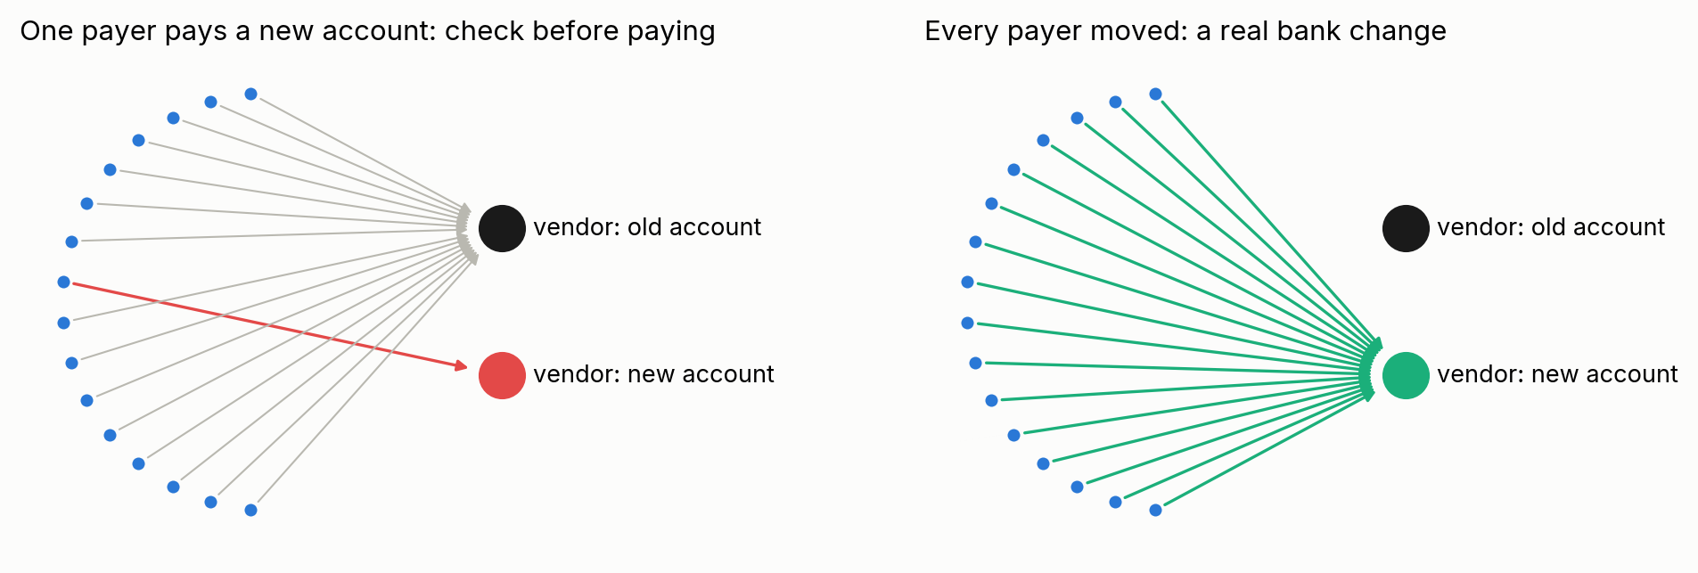
Payee consensus: is this new bank account real?
MODULE 4 · TWO HOPS
One payer’s account view sees a normal payment to a known vendor. The network sees all of the vendor’s payers: a real bank change shows up for nearly all of them, a fraudulent one for one.
Notes:
Business email compromise: "our bank details have changed". In the lab four vendors have between 50 and 100 payers each. Two fraud cases: one payer out of about 60 or 100 uses a new account. One real move: all payers switch in the same month. One vendor with no change. A simple share-of-payers rule separates them. Note: this pools data across clients, so it needs its own governance check before use on real data.

Slide 30
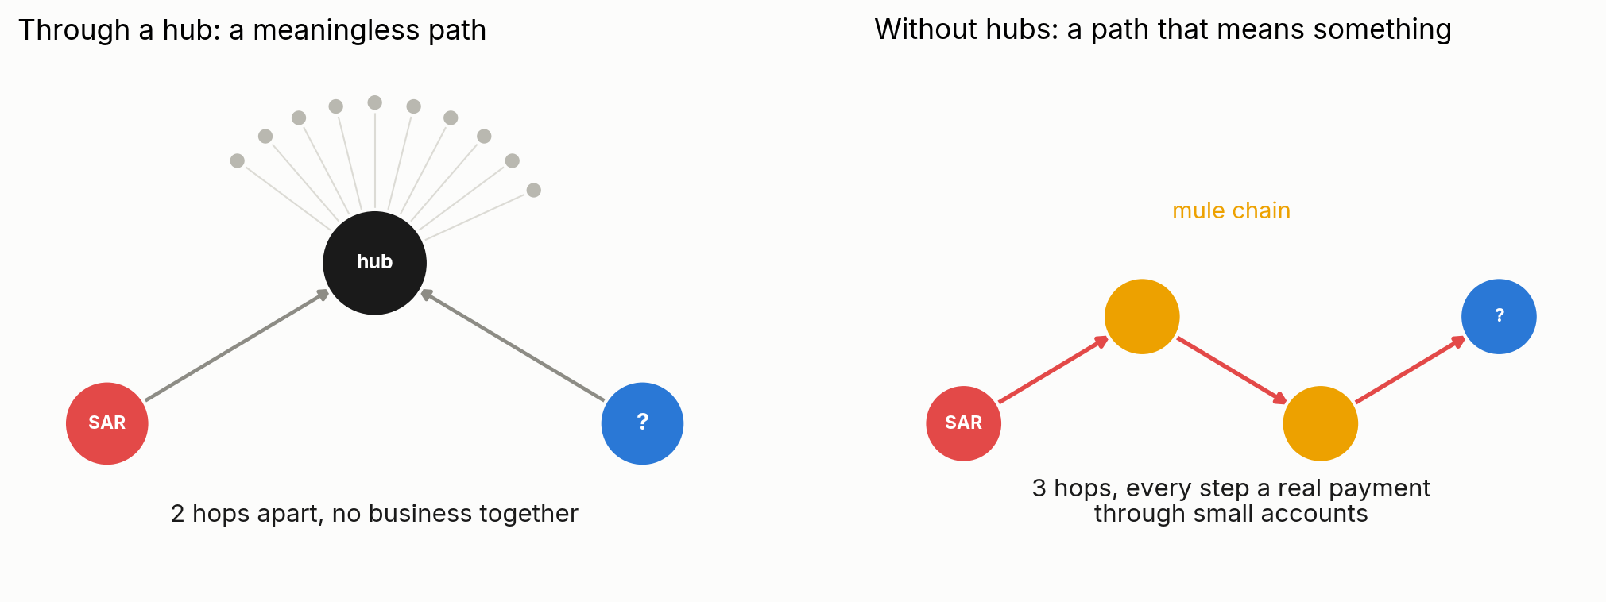
Is there a path from a known bad account to this one?
MODULE 4 · FRAUD
Hops from fraud
Only without hubs
Follow time and direction
shortest distance to any confirmed case, as a feature or a review filter.
otherwise everyone is 2 hops from every fraud case.
money must move forward: a path whose payments happen in order, within days.
Notes:
Breadth-first search from all confirmed cases at once, capped at 3 or 4 hops, gives every account its distance in one pass. Restrict to payments in date order and the path becomes a money trail, not just a connection. Lab 2's fast-out share is the one-hop version of this timing rule.

Slide 31
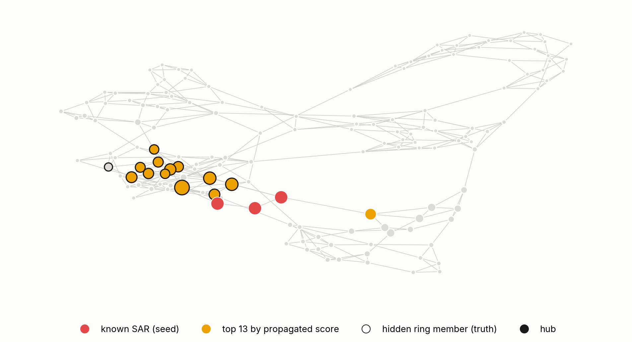
Spreading suspicion from known cases
MODULE 4 · FRAUD
Start from 3 known cases. Let the score flow along payments (personalized PageRank, a form of label propagation).
12 of 13 hidden ring members in the top 13
9 of the 10 that never paid or received from a known case are still found.
Toy graph. The output is a review queue for investigators, not a decision.
Notes:
Each step, an account takes a share of its neighbours' suspicion and a little goes back to the seeds; after a few rounds the score is high for accounts many short paths away from known cases. A rule on direct contact finds only the 3 members touching a seed. Never use real SAR or flagged customers in a classroom: suspicious-activity information is confidential by law. In production, run it with hubs removed, report the score with its reasons (which seeds, which paths), and let investigators decide.

Slide 32
Communities
MODULE 5 · 20 MINUTES · LAB 3
Groups that trade more with each other than with anyone else: ecosystems, not industry codes.
Notes:
Break before this module. Lab 3.

Slide 33
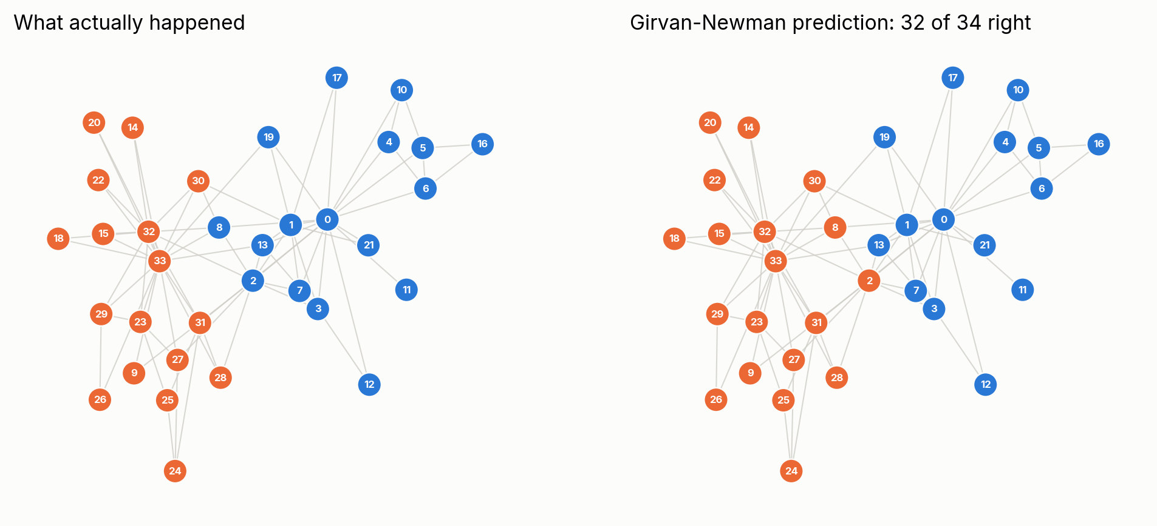
The network knew who would leave with whom
1977 · ZACHARY’S KARATE CLUB
A club of 34 split after a dispute. From the friendships recorded before the split, community detection puts 32 of 34 members on the right side.
Notes:
Wayne Zachary recorded interactions among 34 members of a university karate club; the club split between the instructor (node 0, Mr. Hi) and the officer (node 33). Girvan and Newman (2002) remove the edge with the highest betweenness again and again until the network falls apart; the first split is the prediction. NetworkX ships this graph with the real split, so the lab can check itself.

Slide 34
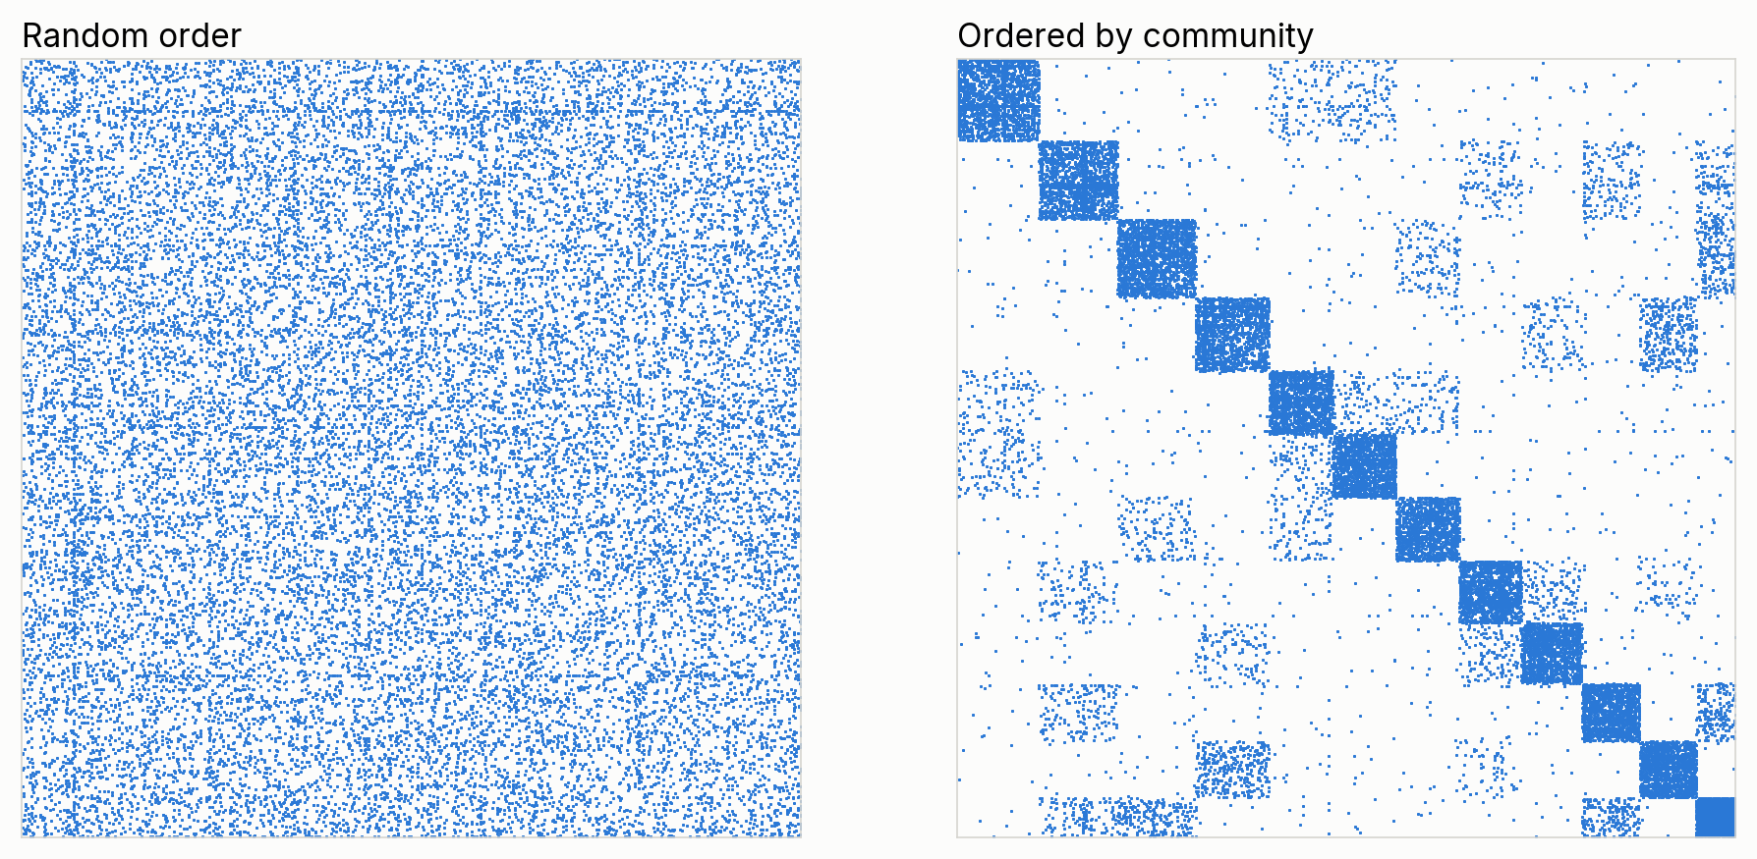
The same matrix, sorted by community
MODULE 5 · COMMUNITIES IN THE PAYMENT NETWORK
Each dot is a payment relationship. Communities are the dense blocks on the diagonal.
Notes:
Same data both times, only the row and column order changes. The off-diagonal blocks are links between ecosystems: neighbouring supply chains. This is the picture to keep in mind for what Louvain optimises.

Slide 35
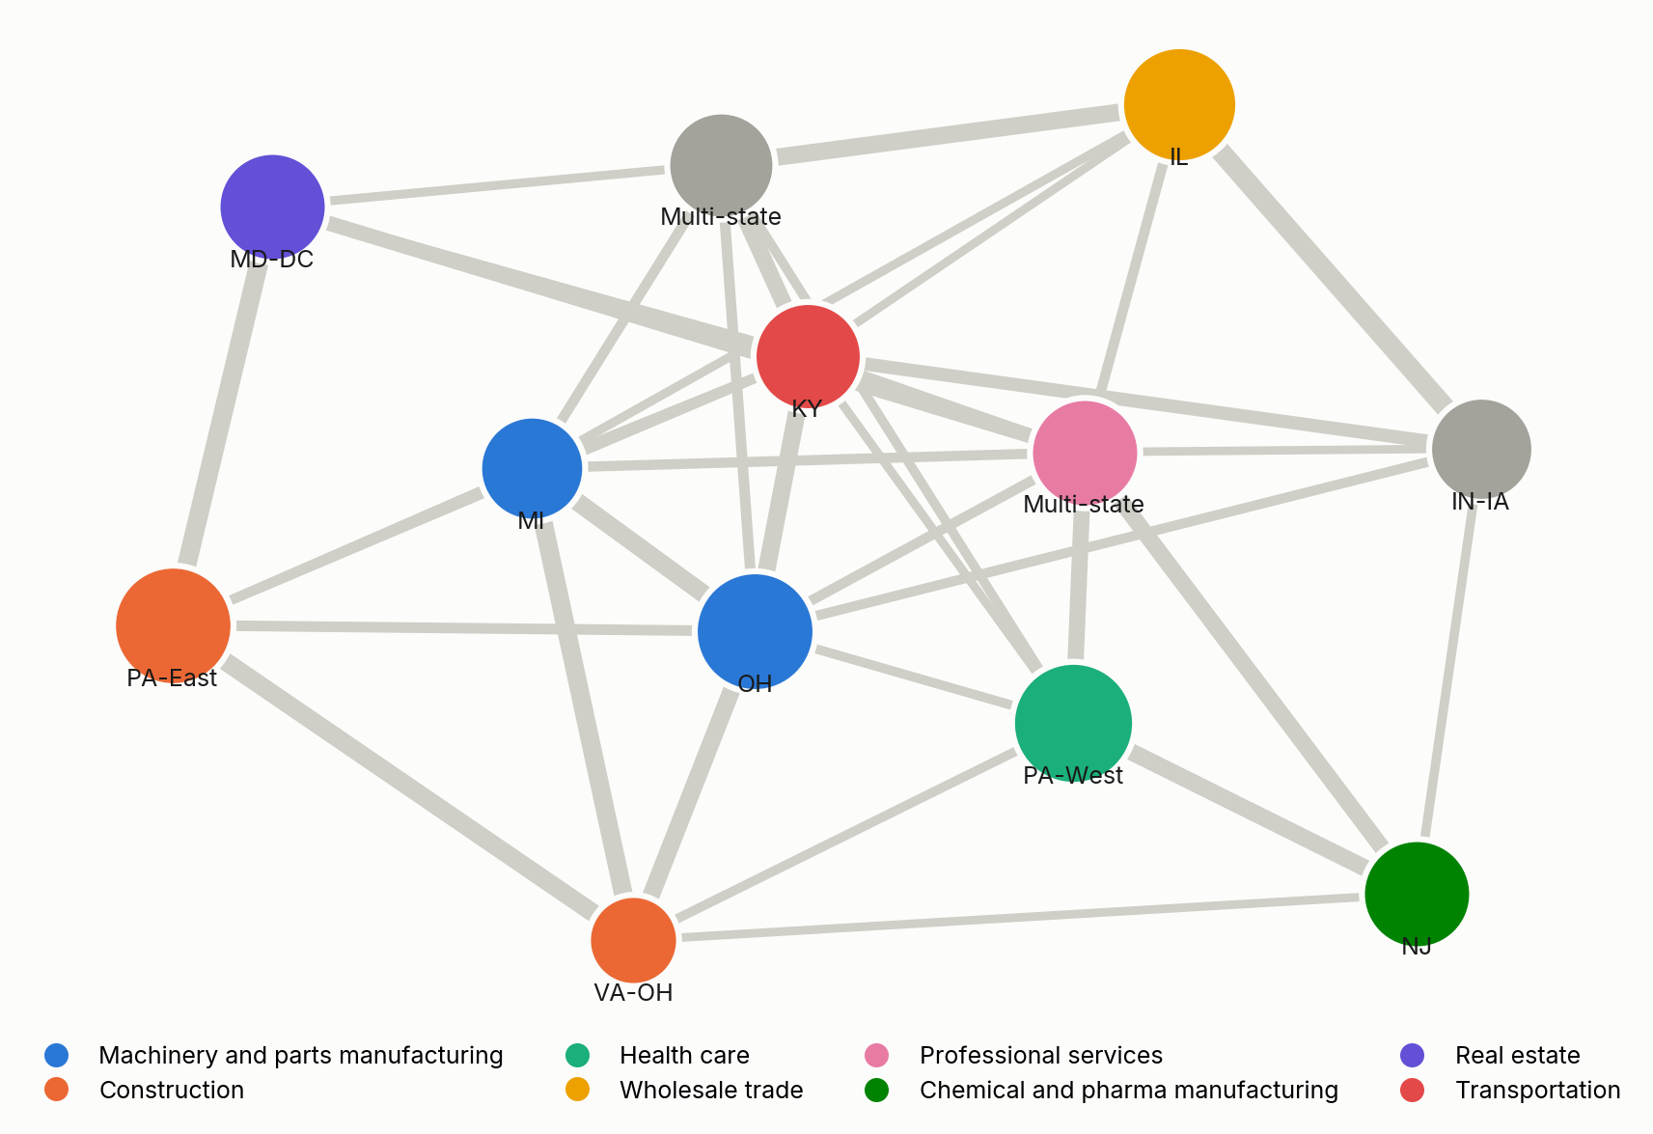
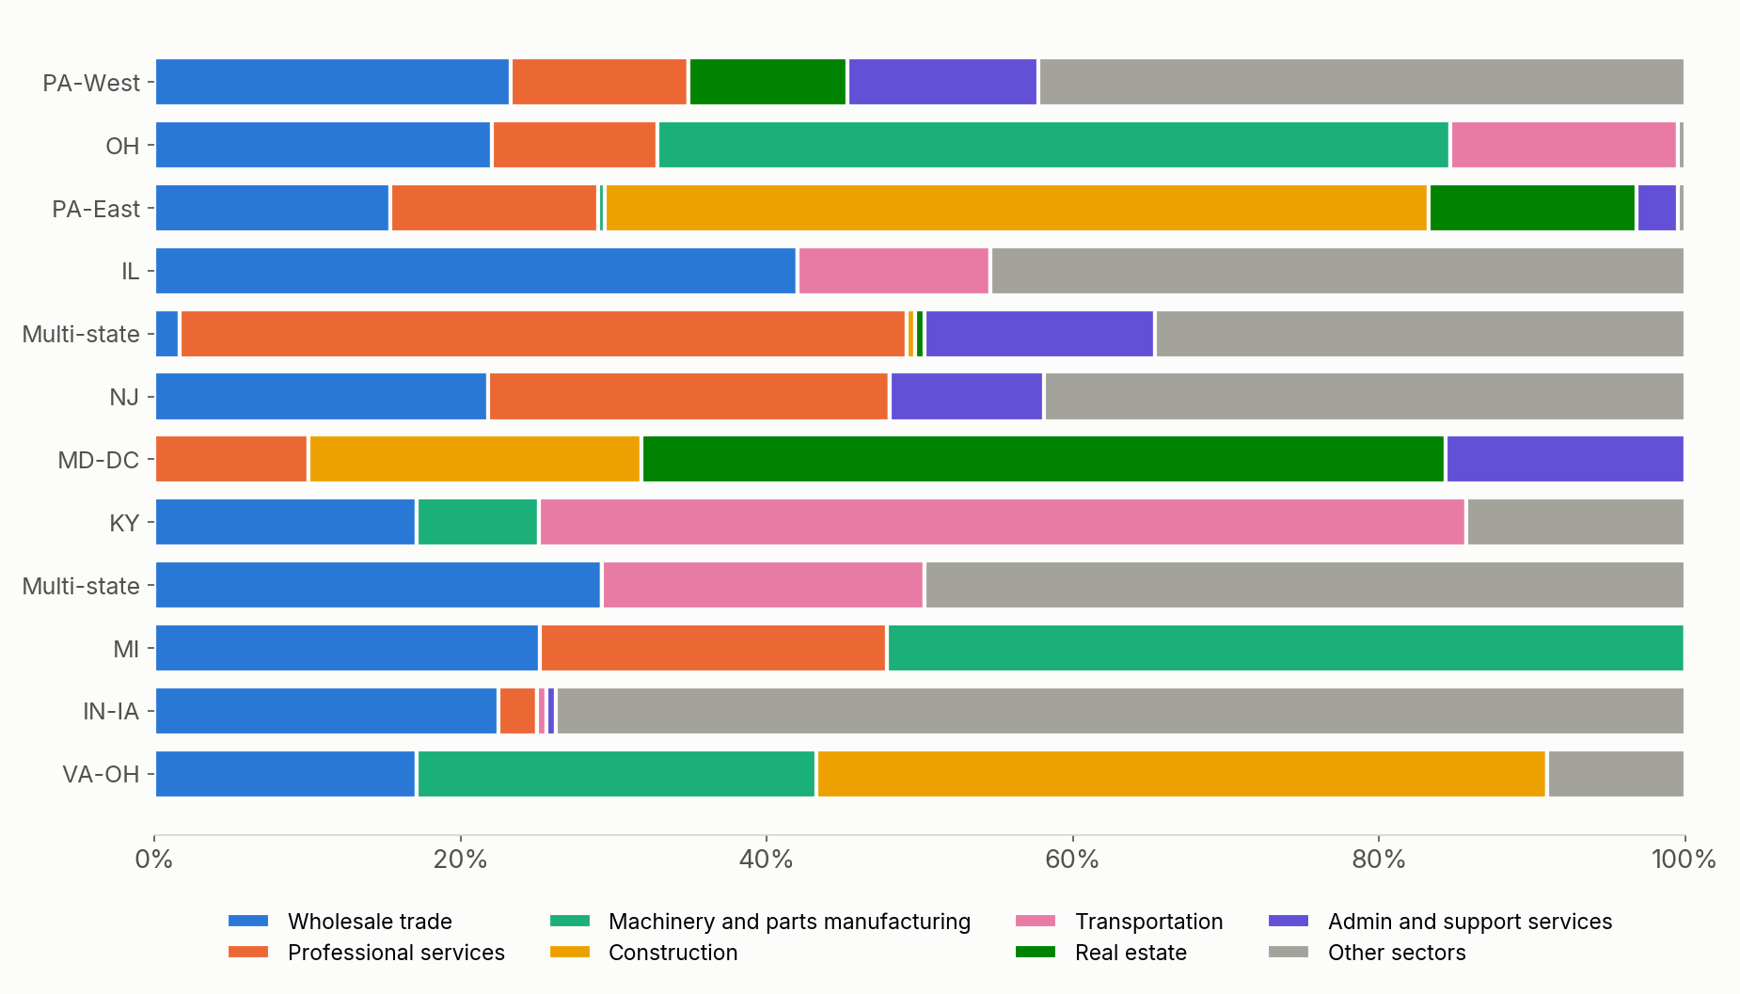
A community is a place and a supply chain, not an industry code
MODULE 5 · ECOSYSTEMS
One bubble per community, labelled by its main region
Sector mix: regions are about 95% pure, sectors about 45%
Notes:
Each community's main region covers 90 to 100% of its members; its main sector only 40 to 60%. Hospitals sit with their suppliers, cleaners and property managers; carmakers with parts makers and truckers. An industry code alone would never group them. The real-data notebook draws this same map for our own network.

Slide 36
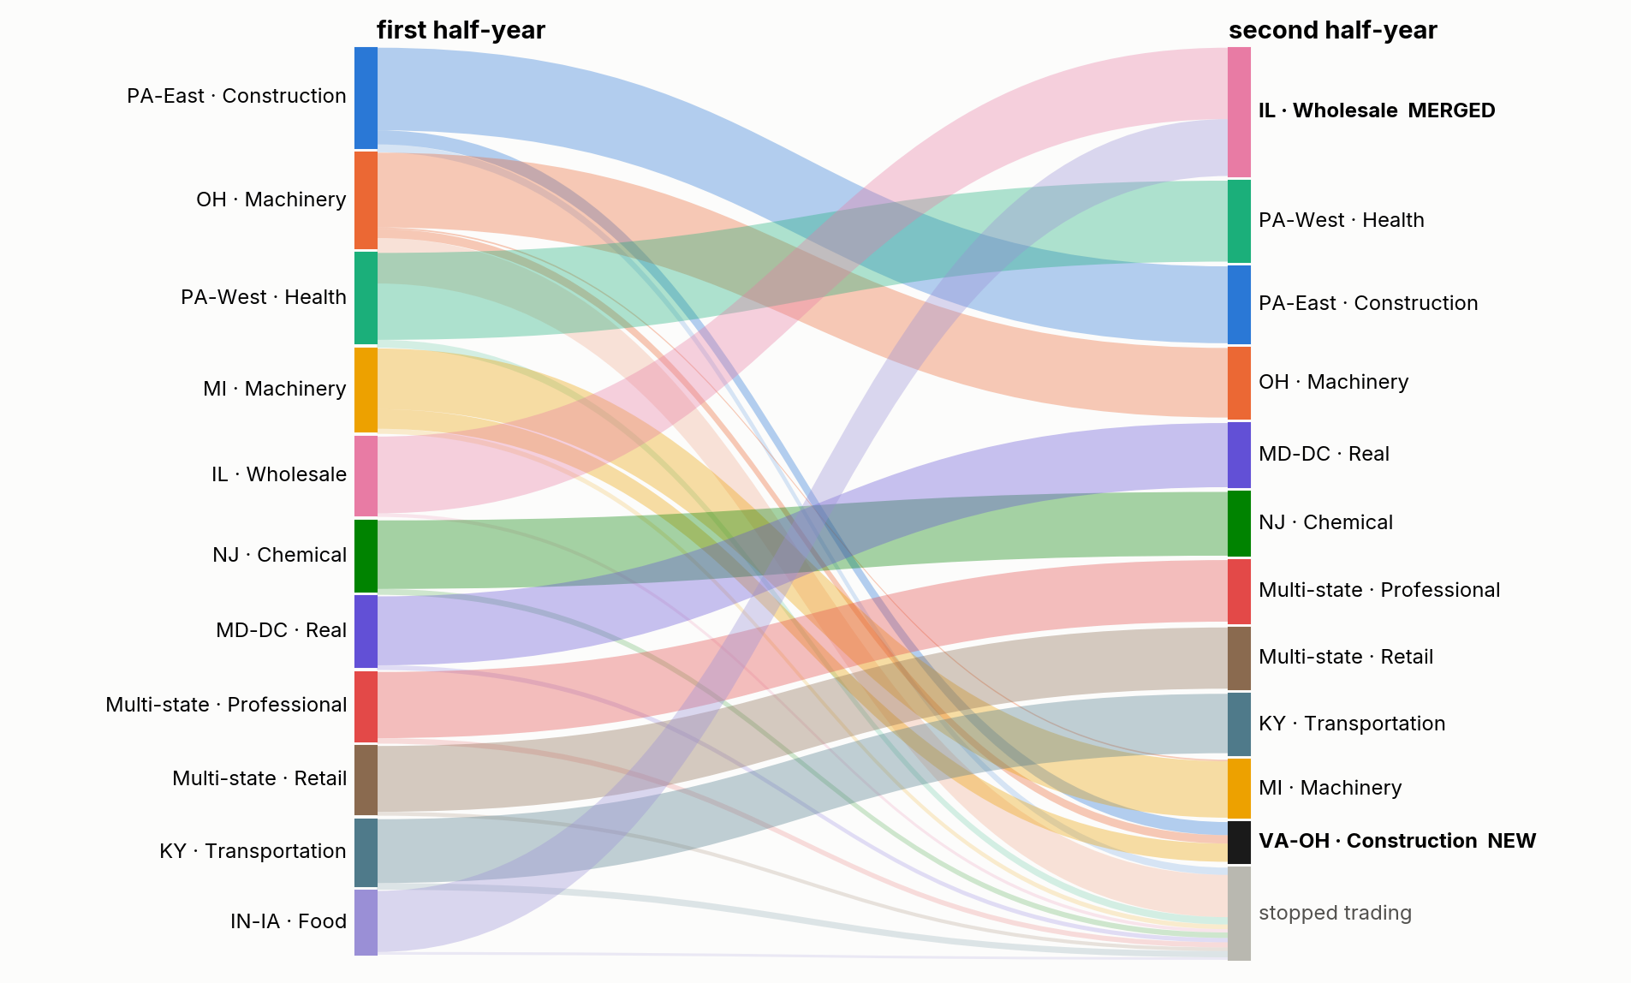
Events no single customer has
MODULE 5 · OVER TIME
Birth: firms that traded elsewhere start trading with each other (a new build-out)
Merge: a new contract wires two ecosystems together
Shrink: an ecosystem loses members and flow
Notes:
Detect communities in each half-year separately, then match them by shared members. A community born in H2 has no H1 community that gave it a quarter of its members; a merge has two parents. This is where market intelligence lives: emerging ecosystems are prospects, shrinking ones are risk. Two caveats: random seeds move small communities around, so events smaller than the run-to-run noise are not real; and clients joining or leaving the bank look like economic change, so track a stable panel. Our network is the bank's slice of the economy, not the economy.

Slide 37
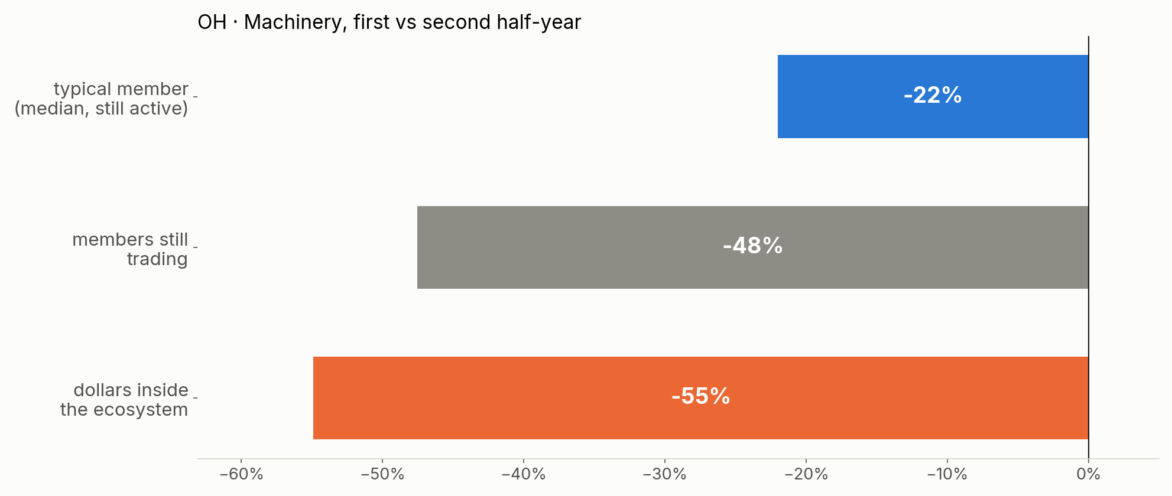
Each member looks a bit down. The ecosystem lost half.
MODULE 5 · ACCOUNT VIEW VS ECOSYSTEM VIEW
Customer-level monitoring sees a typical decline of a fifth. Only the network shows that the ecosystem these customers depend on is coming apart.
Notes:
The shrinking ecosystem in the synthetic data. Surviving members' own volume: median minus 22%. Members still trading by the end of the second half-year: minus 48%. Dollars flowing inside the ecosystem: minus 55%. The fallacy of composition: each individual change is small and noisy, the ecosystem's change is large and consistent. A client's risk depends on its counterparties' health, which is not in its own metrics.

Slide 38
Beyond independent rows
MODULE 6 · 25 MINUTES · LAB 4
Why connected customers break a basic assumption of classic ML, and how much the connections are worth.
Notes:
Lab 4, sections 1 and 2.

Slide 39
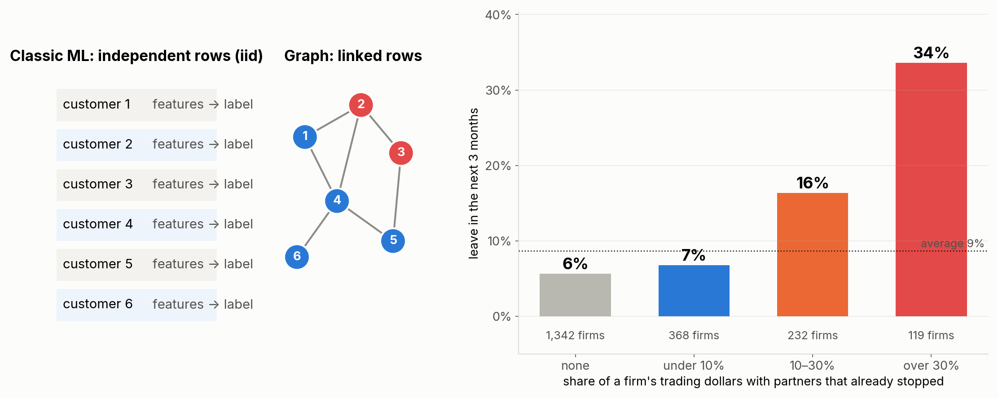
Classic ML assumes customers are independent. They are not.
MODULE 6 · BEYOND IID
Signal in neighbours
Leaky splits
Errors move together
your partners' fate predicts yours: 6% to 34%. A row-by-row model cannot see it.
linked customers on both sides of a random split inflate test scores. Split by group or time.
a whole ecosystem can fail at once; independent-error intervals are too narrow.
Notes:
iid: independent and identically distributed. Two reasons it fails on a network: homophily (partners resemble each other: same region, same supply chain) and contagion (one partner's outcome changes the other's). The chart is computed on the synthetic network: firms whose partners already went silent leave far more often. Graph features are the simple way to put neighbours back into a row; GNNs are the other.

Slide 40
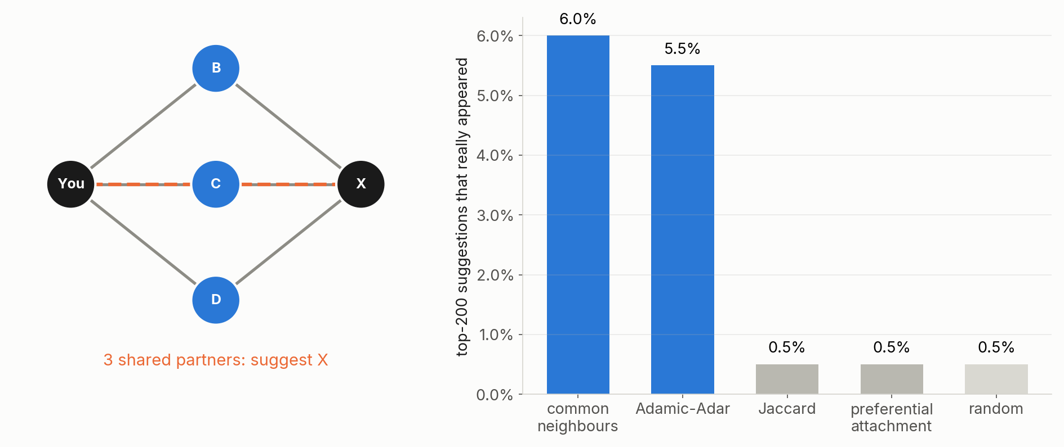
People You May Know, for payments
MODULE 6 · LINK PREDICTION
Learn on the first half-year, check which new relationships appeared in the second. Shared partners beat a random pair about 24 times over; most suggestions are still wrong.
Notes:
Triadic closure: if you pay B and B pays X, you and X are likely to meet. Common neighbours and Adamic-Adar (which gives more credit to selective shared partners) both work; Jaccard and preferential attachment do not here. A random pair has a 0.25% chance of becoming a relationship; the top 200 by shared partners hit about 6%. Only about a fifth of new relationships were two hops apart beforehand: most come from outside your neighbourhood. In practice: a ranked "businesses like you also pay" list for a relationship manager.

Slide 41
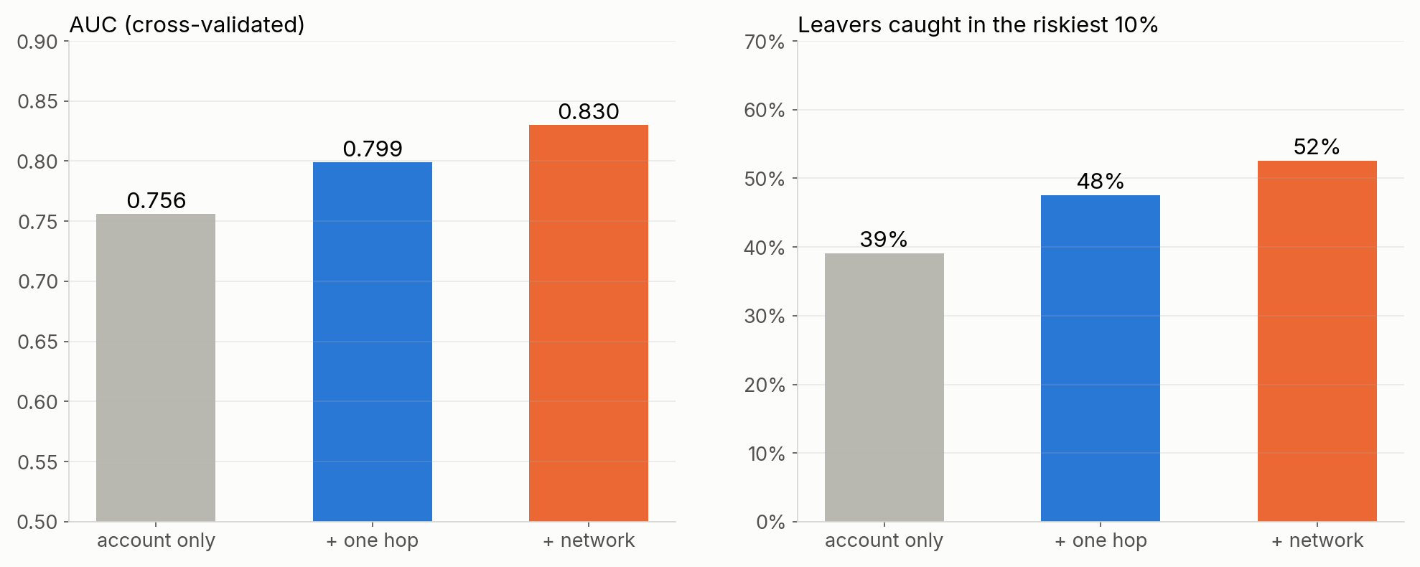
Same model, more graph: who stops transacting?
MODULE 6 · THE WORKHORSE
Account only: own amounts, payment counts and their trend
+ one hop: distinct payers and payees, and their trend
+ network: are my partners leaving or cutting back?
Notes:
Gradient boosting (LightGBM), five-fold cross-validation, synthetic data with churn planted: some businesses drop suppliers before leaving (visible in one-hop features), some leave when their main partner leaves (visible only through the partner: network features), and one ecosystem is shrinking. The biggest lift comes from cheap one-hop features, which matches our own attrition finding that distinct institutions paid was the best single signal. Network features add what the customer's own data cannot show.

Slide 42
How much the connections are worth
MODULE 6 · BEYOND IID
Churn model
Sector of unknown businesses
0.756 → 0.830
AUC, account features → plus network features. Top-10% capture 39% → 52%.
35% → 60%
accuracy, own features → own plus neighbours (SGC).
New relationships
Hidden mule ring
24 ×
better than random from shared partners alone.
12 of 13
found from 3 known cases; a direct-contact rule finds 3.
Notes:
All four come from the synthetic data in the labs, so the exact numbers are planted; the direction is what transfers. On our real data the attrition work found distinct counterparties paid to be the strongest early signal, a degree feature. Same model, same algorithm: only the columns changed.

Slide 43
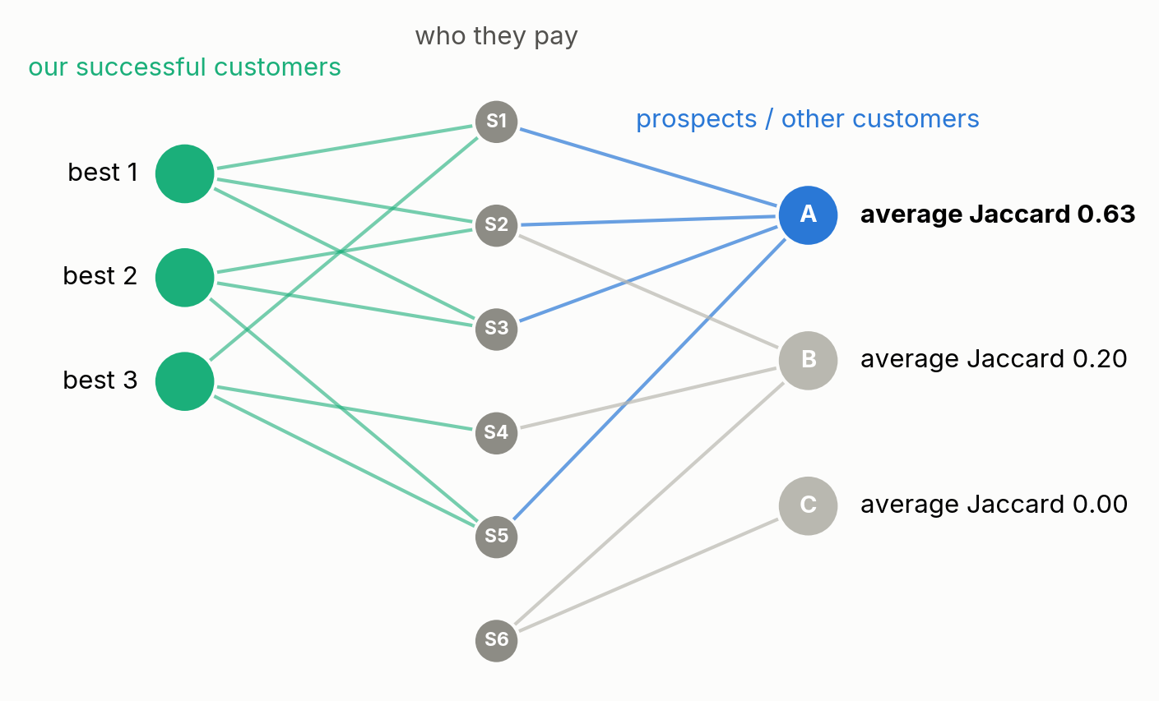
Customers who look like our best customers
MODULE 6 · SIMILARITY
Similar = pays the same counterparties. Jaccard: shared partners divided by all partners.
Product recommendation: customers who look like holders of a product but don't have it.
Prospects: businesses at other banks with the same counterparty pattern as our best clients.
Hubs out first: sharing the power company says nothing.
Prospecting with payment data waits on the permissible-use review.
Notes:
Proximity similarity: shared partners, as here. Role similarity: same shape of neighbourhood even with no partners in common, which is what embeddings capture in Module 8. For look-alikes, average the Jaccard to a set of successful customers, or compare embeddings. Down-weight popular partners the way Adamic-Adar does.

Slide 44
Contagion and geography
MODULE 7 · 15 MINUTES
Who is hurt when a sector breaks, and where we should grow.
Notes:
Contagion is current work; the geography slide refers to the counterparty locatability work.

Slide 45
In an uncertain economy, exposure is a network question
MODULE 7 · CONTAGION
If the AI build-out stalls
If the bond market breaks
Direct vs indirect
data centres, chip and equipment suppliers, power, construction contractors, and the landlords and caterers around them.
rates jump: leveraged borrowers, commercial real estate, funds forced to sell, and the businesses that depend on them.
direct exposure is on our books. Indirect exposure is in the payments: clients paid by the stressed sector, and their suppliers.
Early warning
Backtest first
Single points of failure
payments from a counterparty arriving later or smaller, weeks before trouble shows in balances.
replay a past shock: the 2026 oil-price shock on transportation and airlines.
a hub that fails takes its whole neighbourhood: Change Healthcare, 2024.
Notes:
A sector filter finds the firms in the stressed sector. It does not find the caterer whose biggest payer is a data-centre contractor, or the trucking firm whose customers are airlines. The payment network does. Delayed payments are the signal to monitor: a counterparty that starts paying our client later is often in trouble before anything else shows.

Slide 46
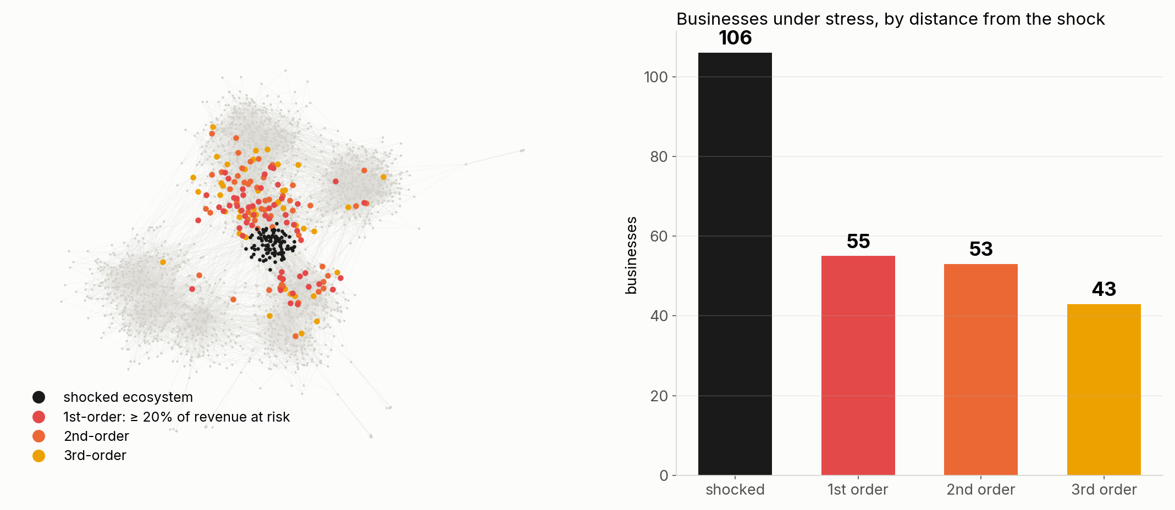
Shock one ecosystem, follow the money
MODULE 7 · CONTAGION
Shock the data-centre build-out ecosystem (106 businesses). A business is stressed when at least 20% of its incoming dollars come from stressed payers. 151 businesses outside the shocked ecosystem are hit, up to 3 hops away: exposure no list of the shocked firms would show.
Notes:
Synthetic network, last six months, hubs removed: a utility paid by everyone would otherwise spread the shock to everyone. The rule is deliberately simple: each round, revenue at risk is the share of incoming dollars from stressed payers, weighted by how stressed they are. Real versions add credit lines, payment timing and the option of finding new customers. The point is the shape: second- and third-order exposure is as large as first-order.

Slide 47
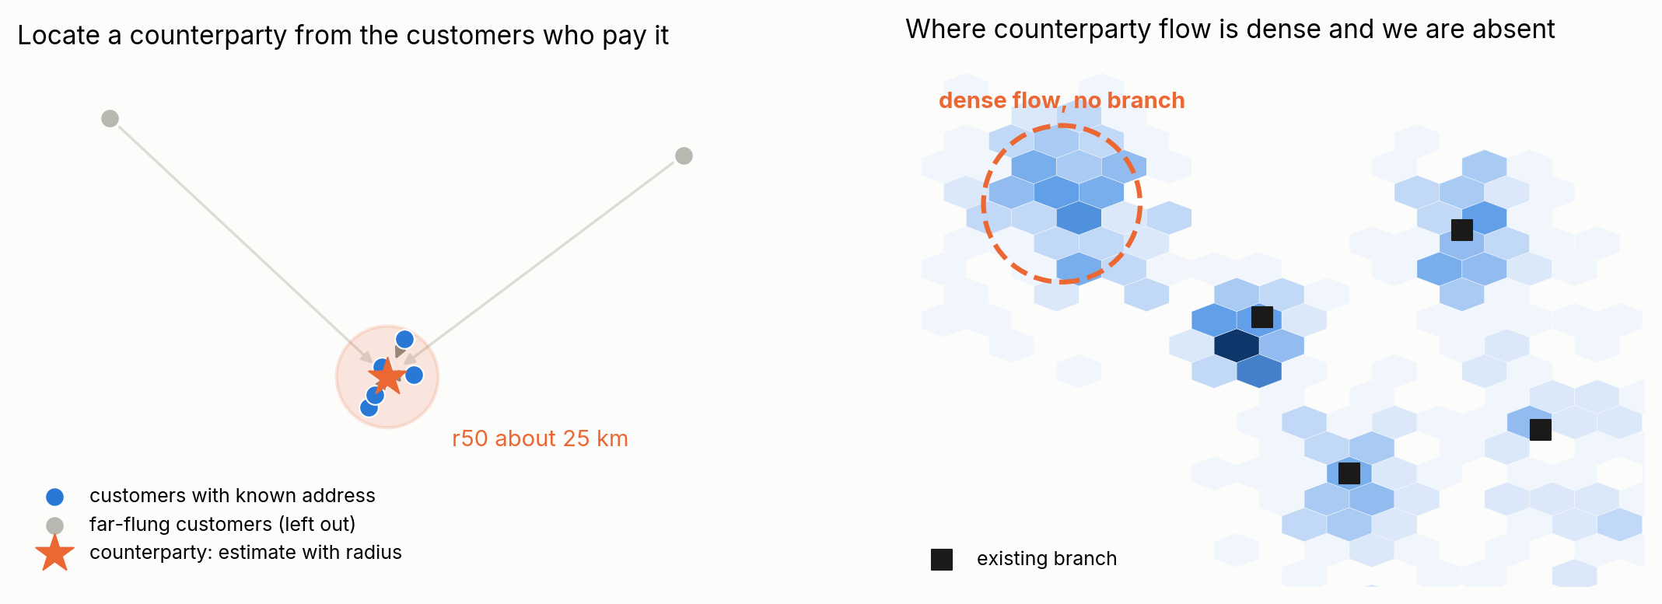
Where are our customers' counterparties, and where should we be?
MODULE 7 · GEOGRAPHY
Locate
Expand
Caveats
a counterparty is near the customers who pay it: use the tightest group, report a radius, never a bare point.
dense counterparty flow where we have few customers is a market we are missing; a candidate for the next branch.
we only see our footprint; permissible-use review, and a fair-lending view for any geography-driven decision.
Notes:
Our locatability work does this as one round of hand-weighted message passing: take the customers who pay a counterparty, keep the tightest k, and return a centre with a radius and a confidence. Utilities came out best: median error about 28 km, 69% within 50 km. A registry classifies the hubs by how well they locate (to a point, a metro, a region, or not at all): degree does not decide locating power, how spread out the payers are does. The right-hand picture is illustrative.

Slide 48
Embeddings and a glimpse of GNNs
MODULE 8 · 5 MINUTES · LAB 4
Vectors for nodes, neighbour averaging, and where learning on graphs pays off.
Notes:
Lab 4, sections 3 and 4. Five minutes: show the FastRP slide and the proximity-vs-role slide; the GNN slides are for anyone who wants more, or the first to cut.

Slide 49
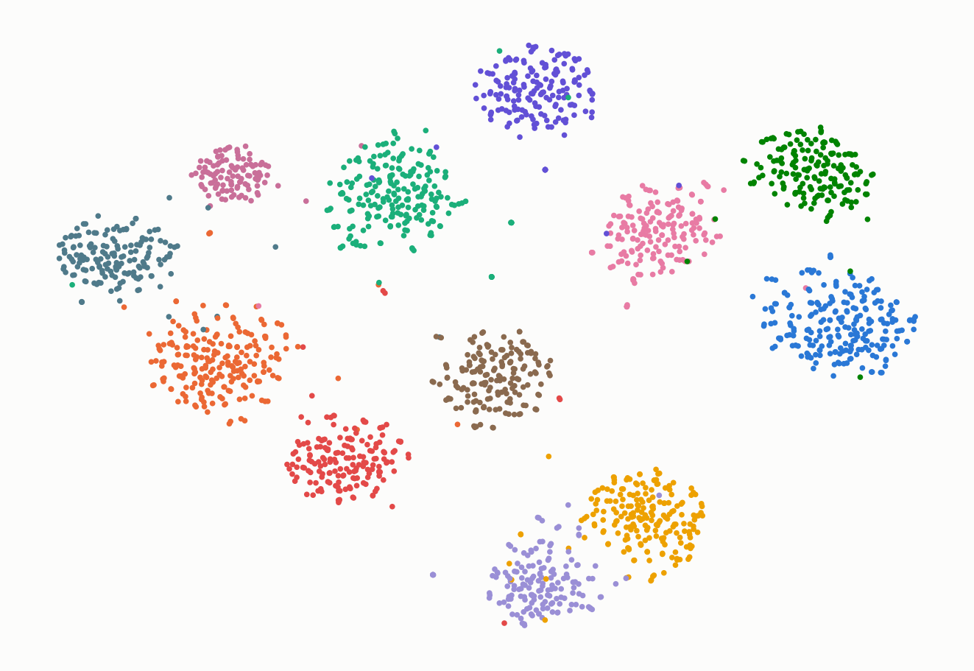
FastRP: a vector per node, no training
MODULE 8 · EMBEDDINGS
1. Give every node a random sparse vector
2. Replace it by the average of its neighbours’ vectors, three times
3. Add up the steps
Each step is a sparse matrix multiply: a join plus a group-by, so it runs in Spark.
Notes:
Fast random projection, Chen et al. 2019; also what Neo4j's graph data science library uses for fast embeddings. 64 numbers per business, about fifteen lines of scipy in the lab. Squeezed to 2-D with t-SNE, each community becomes its own cloud: the embedding captures who is near whom. A fixed seed keeps embeddings comparable from month to month, which node2vec does not.

Slide 50
Embeddings find who is near you, not who behaves like you
MODULE 8 · PROXIMITY VS ROLE
Five nearest neighbours of a pass-through account
Role measures find same-type neighbours for 100% of funnels and pass-throughs and 80% of round-trippers.
0 of 5
5 of 5
A look-alike search (customers who behave like our registered payment processors) needs role features.
by FastRP embedding are pass-throughs
by role measures from module 3 are pass-throughs
Notes:
FastRP's nearest neighbours of a pass-through are ordinary businesses in the same ecosystems: proximity. Role measures (degrees, throughput, overlap, individual payer share, volume, top payee share) find the other pass-throughs. Choose by the question: who is near me (prospects in my ecosystem) versus who acts like me (processor look-alikes, typology matching).

Slide 51
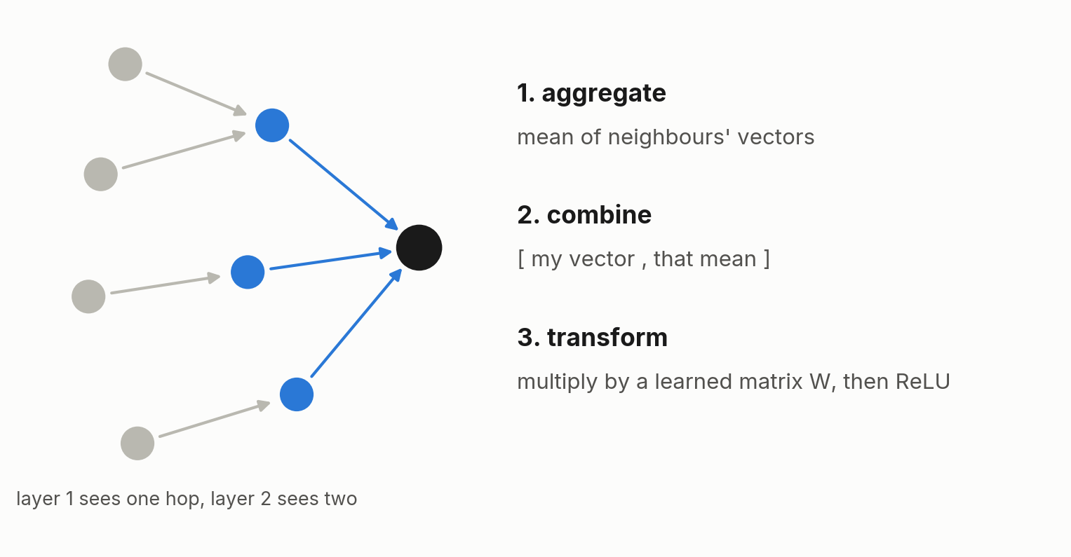
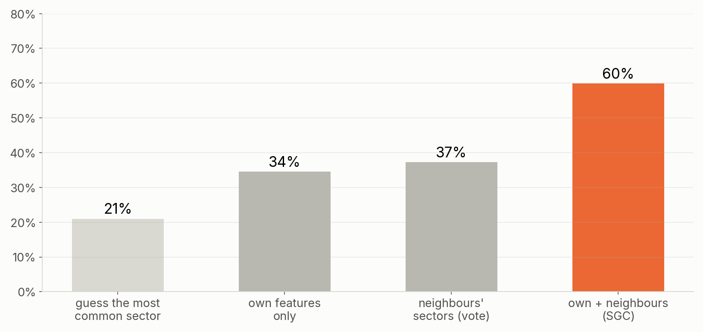
A GNN layer: average your neighbours, multiply by a matrix
MODULE 8 · GRAPH NEURAL NETWORKS
GraphSAGE-style layer; two layers see two hops
Predicting a hidden sector for 30% of businesses
Worth it where labels come free (industry, location, entity type). Rarely worth it as a decision model with scarce labels, mostly one-partner nodes and a model-risk reviewer asking why.
Notes:
GraphSAGE (Hamilton, Ying and Leskovec, 2017) aggregates neighbours with a mean, concatenates with the node's own vector, multiplies by a learned matrix and applies a non-linearity. The right chart uses simplified graph convolution (SGC, Wu et al. 2019): a GNN without the non-linearity, trainable with plain logistic regression. Own features alone 35%, neighbours' sectors alone 37%, both together 60%. The cheap test before any GNN project: add embeddings to the existing model and see whether the AUC moves.

Slide 52
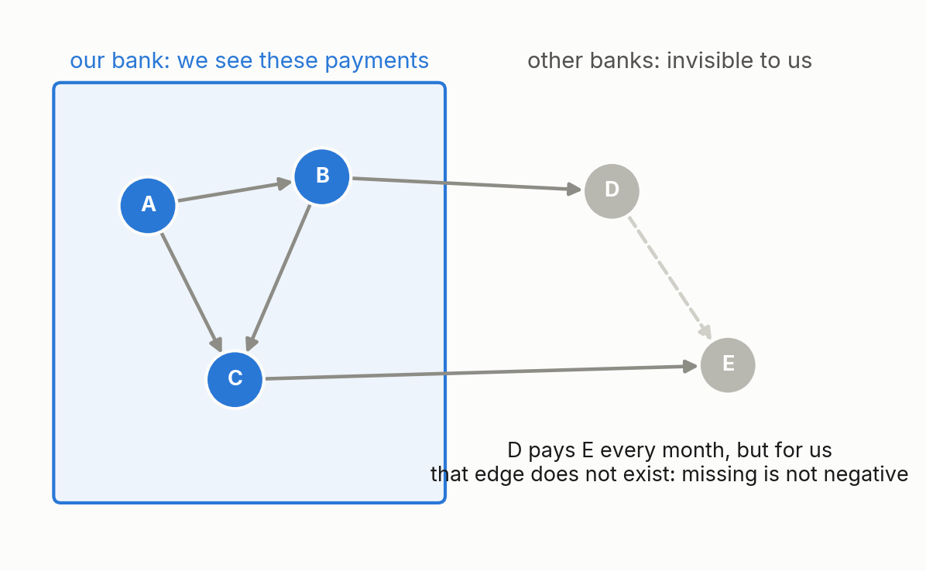
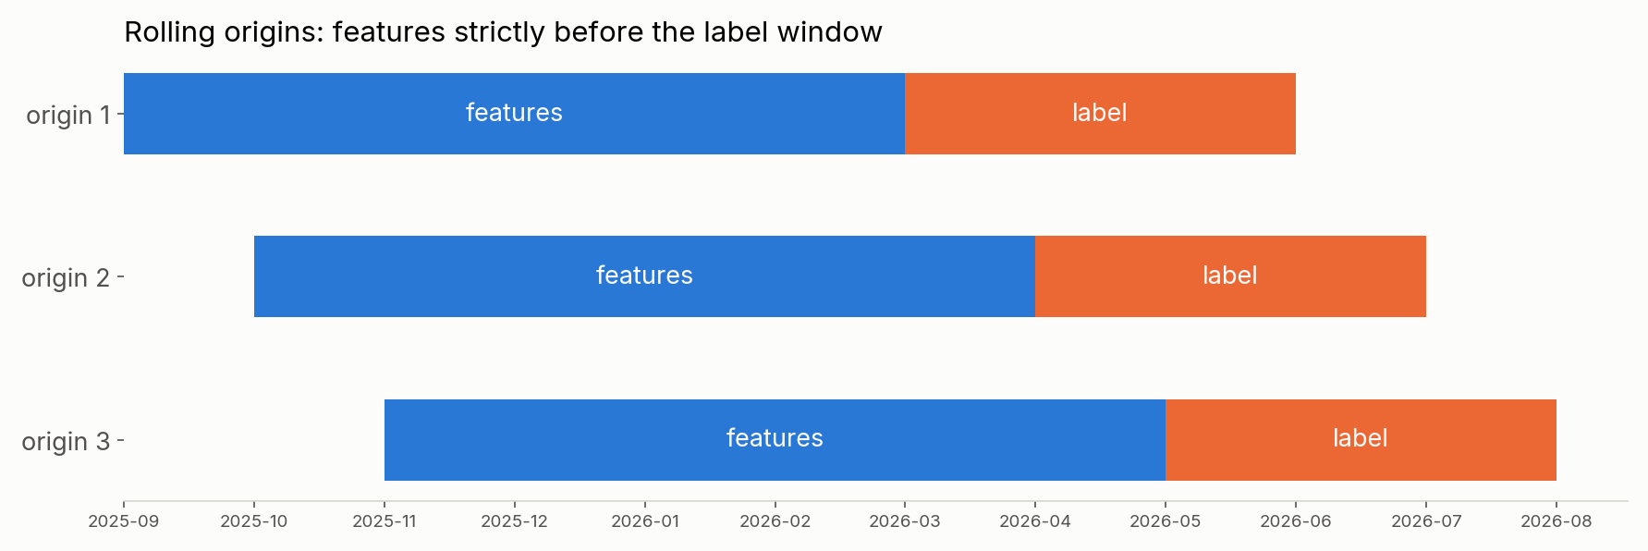
What makes bank graph ML different from the textbook
PITFALLS
Missing is not negative. We only see our side; off-us flows are censored.
Time leakage. Features strictly before the label; rolling origins.
Group leakage. Split folds by parent company, or related customers leak.
Clean first. Hubs out, entity resolution in: one insurer appeared under 250,000 ids.
Degree 1. Most counterparties have one partner and carry almost no signal.
Governance. Explainability for model risk; permissible use before prospecting; never real flagged cases in a classroom.
Notes:
Off-us censoring: a pair that never appears may simply trade through other banks, so link prediction negatives are noisy and coverage must be reported separately from signal. Rolling origins: the label window always sits after the feature window, and every origin is evaluated separately. Group folds: split by master customer id so a parent and its subsidiaries never sit on both sides. Entity resolution: in our own counterparty data the largest name merge folded hundreds of thousands of raw ids into one insurer. Suspicious-activity information is confidential by law.

Slide 53
Which tool for which job
TOOLS
Tool | Good for | Scale and catch
NetworkX | learning, prototypes, small graphs | pure Python: up to about a million edges
cuGraph | PageRank, Louvain, Leiden on GPU | tens of millions of edges in GPU memory
Spark + GraphFrames | one-hop features, connected components | any size; every iteration is a shuffle
Neo4j + Cypher | investigation, multi-hop lookups, pictures | anchored queries, not bulk analytics
PyTorch Geometric | GNN research, GraphSAGE | needs labels, a GPU and a reason
Most of today’s methods are a SQL group-by or a sparse matrix multiply away.
Notes:
One-hop features (degrees, overlap, throughput, partner trends) are plain Spark group-bys over an edge table, which is how our customer metrics are built. Whole-graph algorithms (PageRank, communities) go to cuGraph or GraphFrames. Neo4j is the investigation and visualisation layer: the Panama Papers journalists (ICIJ, 2016) used Neo4j with Linkurious to explore 11.5 million leaked files; the investigation won a Pulitzer.

Slide 54
How our map was made
BACK TO THE HOOK
1. One month of customer-to-customer payments, businesses on both ends
[ community_map.png or a drill-down from the notebook ]
2. Weight = log of dollars; remove the hubs
Open community_map.html for the live version
3. Leiden on the GPU
4. One bubble per community, coloured by main sector
5. Drill into one community, names masked
Notes:
Every step is something we did in the labs: Lab 1 (hub removal), Lab 3 (communities, community map, composition). Walk through the real map: the largest communities, their main sectors and purity, the strongest links between communities, then open a drill-down. Point out mixed-sector communities: ecosystems, not industries. Keep the files on your screen only.

Slide 55
What the account view cannot see
TAKEAWAYS
Find the hubs first
One hop is cheap and strong
name them and decide per task. Centrality, paths, similarity and contagion all change with them.
Degree, overlap and throughput find funnels, pass-throughs and round trips. Timing clears the look-alikes.
Communities are ecosystems
Rows are not independent
Place plus supply chain. Their births, merges and shrinks exist only at network level.
Neighbours carry signal: graph features lift the models you already build, spreading from known cases finds hidden ones, and exposure travels hops.
Notes:
Leave the labs and the cheatsheet with the group. The synthetic data generator is in the kit, so anyone can change the planted patterns and rerun. Questions.

